Slide 1
CHOOSE YOUR DIGITAL BRAND
Notes:
1:15 I named this presentation choose your digital brand because I want to make sure everyone is aware from the start that whether you make a conscious decision or not – you already have a brand. By not being intentional about choosing your brand, you are leaving it up to luck. In the digital space, people are forming an opinion of you whether or not you do anything about it. I learned this about 15 years ago when I was at a conference and I ran into a guy who was kind of a big deal in tourism. He asked me how my dog Scout was doing and I was kind of shocked. How on this earth did this big important guy know about my dog Scout? So I asked him and he said oh come on, we are friends on Facebook, you post pictures of that dog all the time, that’s your brand! And it was then that I realized, you can make a choice about your brand or you can roll the dice! I got lucky – Scout was an amazing dog, I named my company after her! But from that point on, I was much more intentional about my brand.
Before I get started, I would love to ask this audience just a couple of questions to find out who we have in the audience. So of course, I need to use some tech to do this – menti.com.

Slide 3
What We’ll Cover
Why Choosing Your Brand Matters
Using Social as a Branding Tool
Helpful Apps
Client Biases
Notes:
1:25 .Thanks for your participation. Now let’s get to the presentation – this is what I want to cover with you. The end goal of this presentation is to get you to up your LinkedIn game, but if you are anything like me, you don’t want to spend your time doing anything that isn’t in your own best interest. I like to know the whys behind what I am doing so I am going to spend a little time explaining why it is so critical today for you to make a conscious effort to choose your brand. Once I have hopefully convinced you, then we will spend the second half talking about how to do it. Finally, we will wrap up with some next steps for you. Let’s get started.

Slide 4
What are our clients up to?
Notes:
We all know what our life has been like since covid, but just what are our clients up to? The nice people at gartner research spend a lot of time thinking about this and they were nice enough to share this with us. They surveyed thousands of businesses – all industries and sizes, and in general found that the steps above was how they are spending their time. See that guy over there to the right? That is you if you are a salesperson, trying to figure out how to make your goals. So quickly, in box one, they are identifying their problems. They think they need to sell more widgets or improve their customer service, or go more digital. Once they have identified their problems, then they want to start figuring out how to solve them – makes sense right? So if they want to sell more widgets, they might need to increase their marketing, and also, make more widgets. If they want to improve customer service, maybe they need to new technology or training. So that takes them to the third box which his where they are going to get a little more specific. They are going to build their requirements – meaning, okay, we are going to build 50% more widgets, and spend $100k more marketing them. Then they go to the 4th box and that is usually when we encounter them because at this point, after doing a lot of internet research, they will probably reach out to us as a vendor. Those two boxes on the bottom are happening during most steps – asking each other, does this seem right? And then trying to get as many people to buy in before moving to the next phase. Now, in truth, these steps don’t always happen in order, sometimes they bounce around.

Slide 5
Notes:
This is a more accurate picture of what is actually taking place. You probably recognize some of these steps in here - You make some progress selling to one person, then they get transferred or their boss has an uncle who did it this way, so you go backwards. You get to the vendor selection phase and the contact you started with disappears so you go back a step. Change in leadership, different priorities.

Slide 6
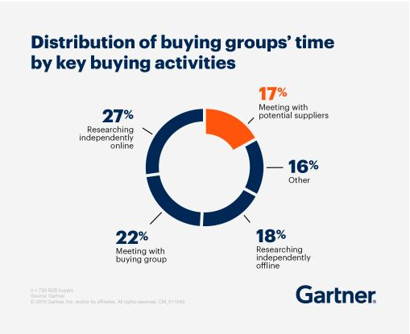
Less Time To Spend With
Salespeople
Notes:
This graphic takes the previous graphic and breaks it out into time spent - how our B2B customers are spending their time buying. This shows pretty clearly how much less time buyers are spending with salespeople, because they are doing so much more research online, spending more time talking to other decision makers within their own organizations so bottom line, salespeople need to show up where their buyers are spending their time in the buying process – which today in the B2B world is LinkedIn..

Slide 7
Where are you in this process?
Nate
Notes:
Well, if you are like too many sales people, let’s call them say, NATE you are way over there on the right, hoping that when your client gets to the vendor selection part, your phone is going to ring or that email is going to bing. And that worked pretty well in the past, for some because there was a lot of business to go around. But as we all know, that is not so much the case today.

Slide 8
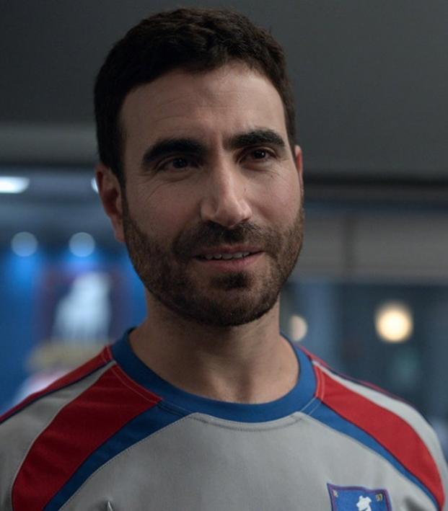
What are your customers up to?
You
You
You
You
Notes:
But the savvier salespeople are figuring out ways to insert themselves at every step along the process. I think of them like Roy Kent. Here I am! Here I am again! Hey, right here! You get the idea.

Slide 9
Where is Roy?
Here
Every Freaking Where
There
ROY
Notes:
So who are you going to be, Nate or Roy? But the truth is, we are not Roy Kent, so if we tried to insert ourselves everywhere, we would likely be shooed out of companies because let’s face it, people have biases about salespeople right?

Slide 10
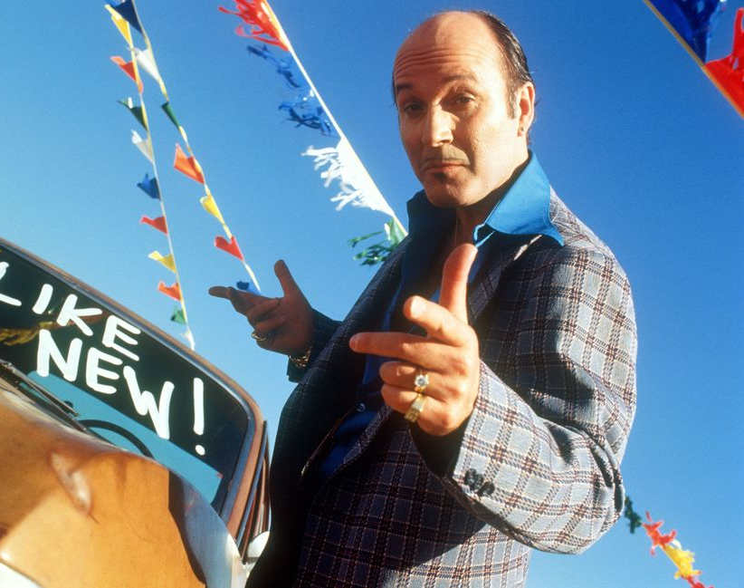
Client Biases
NATE
Nate just wants to push his agenda
Nate will try to sell me anything
Nate doesn’t understand me
Nate is just trying to get my money
Nate is here today, gone tomorrow
Nate is just trying to take up my time
Nate won’t tell me everything
Notes:
1:35 Here is the problem with being Typical Salesperson Nate. So many customer biases.
They just want to make a sale
They will try to sell me anything
They don’t understand me
They are just trying to get my money
But, if we could rebrand ourselves – not as pesky salespeople but instead as say a trusted resource, or a valuable partner, it would be far easier to insert ourselves into the process earlier right?

Slide 11
Cognitive Bias
An error in thinking that happens when people are processing information in the world around them and affects the decisions and judgments that they make.
Often a result of your brain's attempt to simplify information processing.
Notes:
I want to take one more sidestep here and talk about biases. We all have them, and surprisingly, we all have more than one. And for good reason. Here is the definition of a bias – an error in thinking that happens when people are processing information in the world around them and affects the decisions and judgments that they make.
Often a result of your brain's attempt to simplify information processing
And let’s do another quick exercise to see if you too might be subject to this. I am going to give you a math problem – as quickly as you can, please type your answer into the chat box. No googling! Is everybody ready – do you have the chat box open?

Slide 12
How Much Money Do You Have?
Between you and your friend, you have $1.10
You have exactly $1.00 more than your friend.
How much do YOU have?
Notes:
Between you and your friend, you have $1.10
You have exactly $1.00 more than your friend.
How much do YOU have?

Slide 13
$1.05
If you had $1, your friend would have 10 cents
Which means you would only have 90 cents more.
Fast v Slow Thinking – Leads to Bias
Notes:
The answer is $1-05. If you had $1, your friend would have 10 cents
Which means you would only have 90 cents more.
Believe it or not, if you answered incorrectly, it is not necessarily a bad thing. Your brain has two speeds of thinking. Fast thinking and slow thinking. Fast thinking exists to save our lives. It enables us to quickly recognize danger and get out of the way. It is more instinctive, but as you can see, sometimes – often – it can lead us in the wrong directions. Slow thinking is harder. We do it less. It leads to less bias but we – and I mean really almost everyone – except maybe revenue managers – don’t pull out our slow thinking caps as often.
So that leads us with a wide variety of resulting biases.

Slide 14
Cognitive Biases Good or Bad?
Anchoring
1st piece of info sticks.
Availability Heuristic
Covid isn’t real because I don’t know anyone with it..
Framing
Drawing different conclusions from the same info – based on how it is presented
Bandwagon
Everyone else thinks that way, me too..
BIAS
Loss Aversion
Fear of missing out
Clustering
Illusion
See patterns in random events
In Group
People are more likely to support or believe someone within their own social group than an outsider.
Confirmation
Bias
Listen only to that which agrees with your POV
Recency
Last thing you heard.
Notes:
Everybody has multiple biases. Here is a list and description of a handful of typical biases – but it is in no way complete. I could probably name about 20 biases off the top of my head. In our salesperson example, customers might be skeptical because of a recency bias – the last salesperson they dealt with was terrible so that is in their mind. It could also be a little bandwagon bias, everyone says salespeople can’t be trusted so that bias is a little built in.
But the good news is, if we can become a little bias savvy, we can use these biases to our advantage. We are going to explore some of those now as we talk about how we can become more trusted.

Slide 15
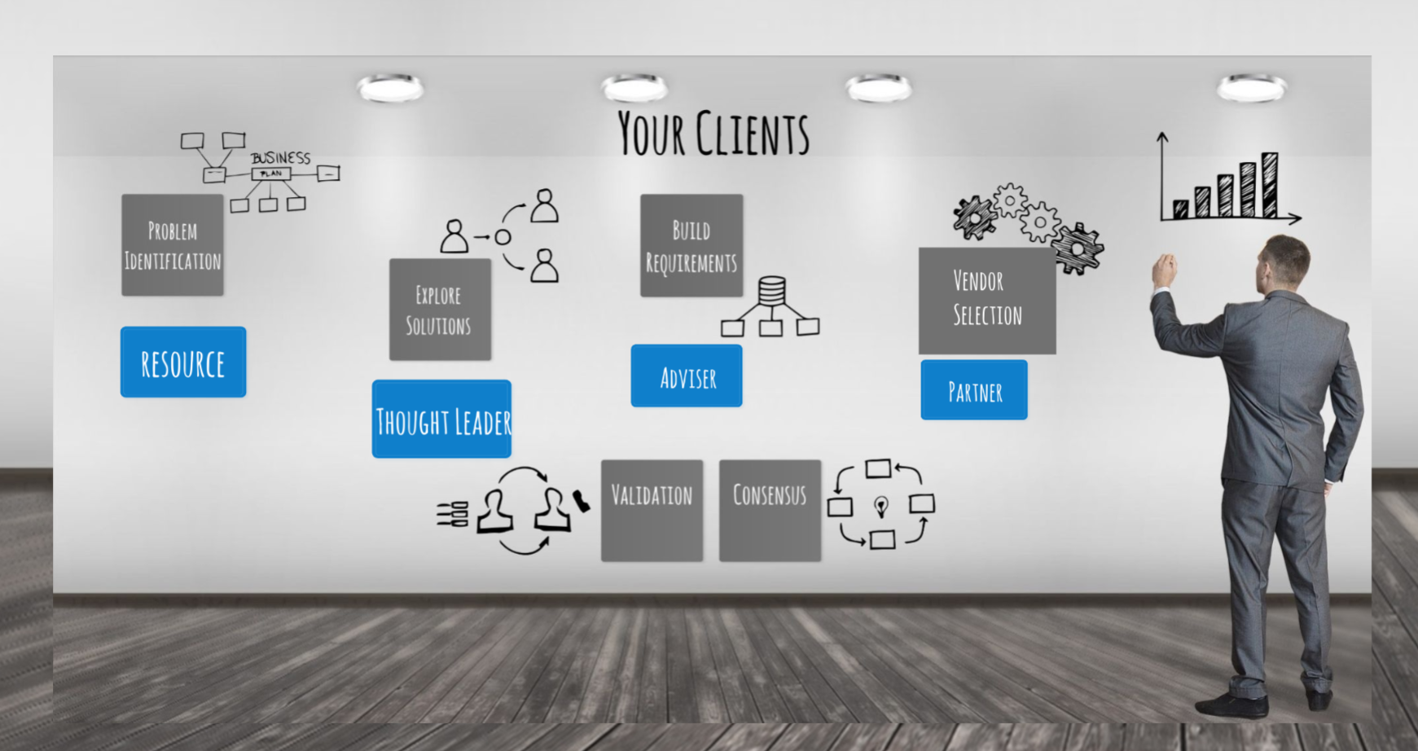
Roy is a Trusted Resource. Why be like Roy?
Insert Yourself Earlier
Anchor Bias
First piece of info sticks
Availability Heuristic
I know that person…
Notes:
By inserting ourselves into the busying process earlier – as a trusted resource instead of a pesky salesperson, we can take advantage of two common biases – the anchor bias which means that typically the first piece of info that you see sticks with you and the second sounds fancy – the availability heuristic, but all that means is that sense of familiarity – I know that person.
Being a trusted resource also has some other advantages.

Slide 16
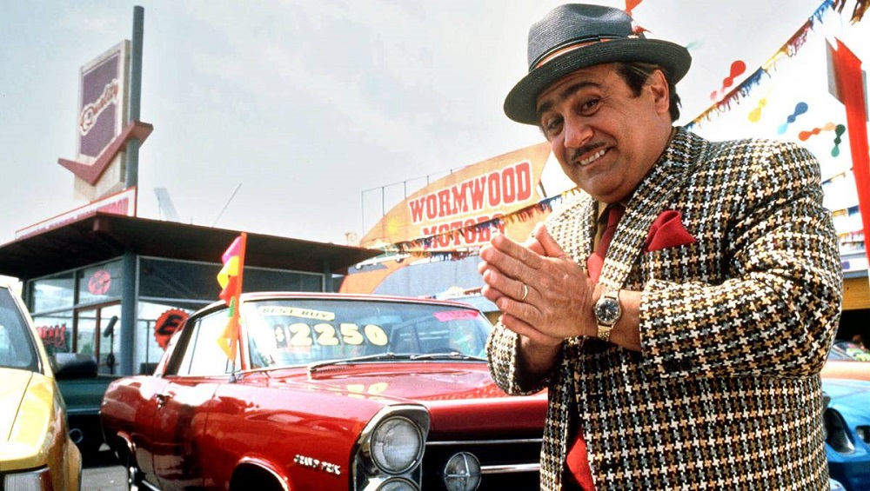
Why be a trusted resource?
Reduce Skepticism believe someone within their own social group than an outsider.
In Group
Familiar v. unknown
The Halo Effect
One thing leaves impression.
Notes:
If someone develops some trust in you – in your knowledge, in your advice, in your brand if you will, you can start to reduce skepticism. There are two more biases that we can appeal to with this approach – the “in group” bias meaning again, this person is familiar to me because we are a part of the same tribe and the halo effect – when I see this person, I think of trusted resource.

Slide 17
Why a be a trusted resource?
Stay Top of Mind
You want to be their go to person
Recency
Last thing you heard
Notes:
And finally, if you can figure out how to position your self as a trusted resource, you will become their go to person, and that will definitely keep you top of mind. So I am hoping I have presented you with enough data to over come any biases you might have brought about becoming a trusted resource. Now, onward to figuring out HOW to accomplish such a valuable goal.
I am hoping at this point I have convinced you of the WHY you want to be a trusted resource. Now, let’s focus on the How.

Slide 18
A Trusted Resource About WHAT???
Technology?
Leadership?
Change Management?
Engagement?
Efficiency?
Notes:
Before we go any further, I am going to help you learn to brand yourself as a trusted resource today. But, YOU will have to decide exactly what you will be a trusted resource about what. Here are some ideas, but you want to consider two things. What interests you AND what your clients are talking about – or need. If you don’t know – I have an app for that!

Slide 19
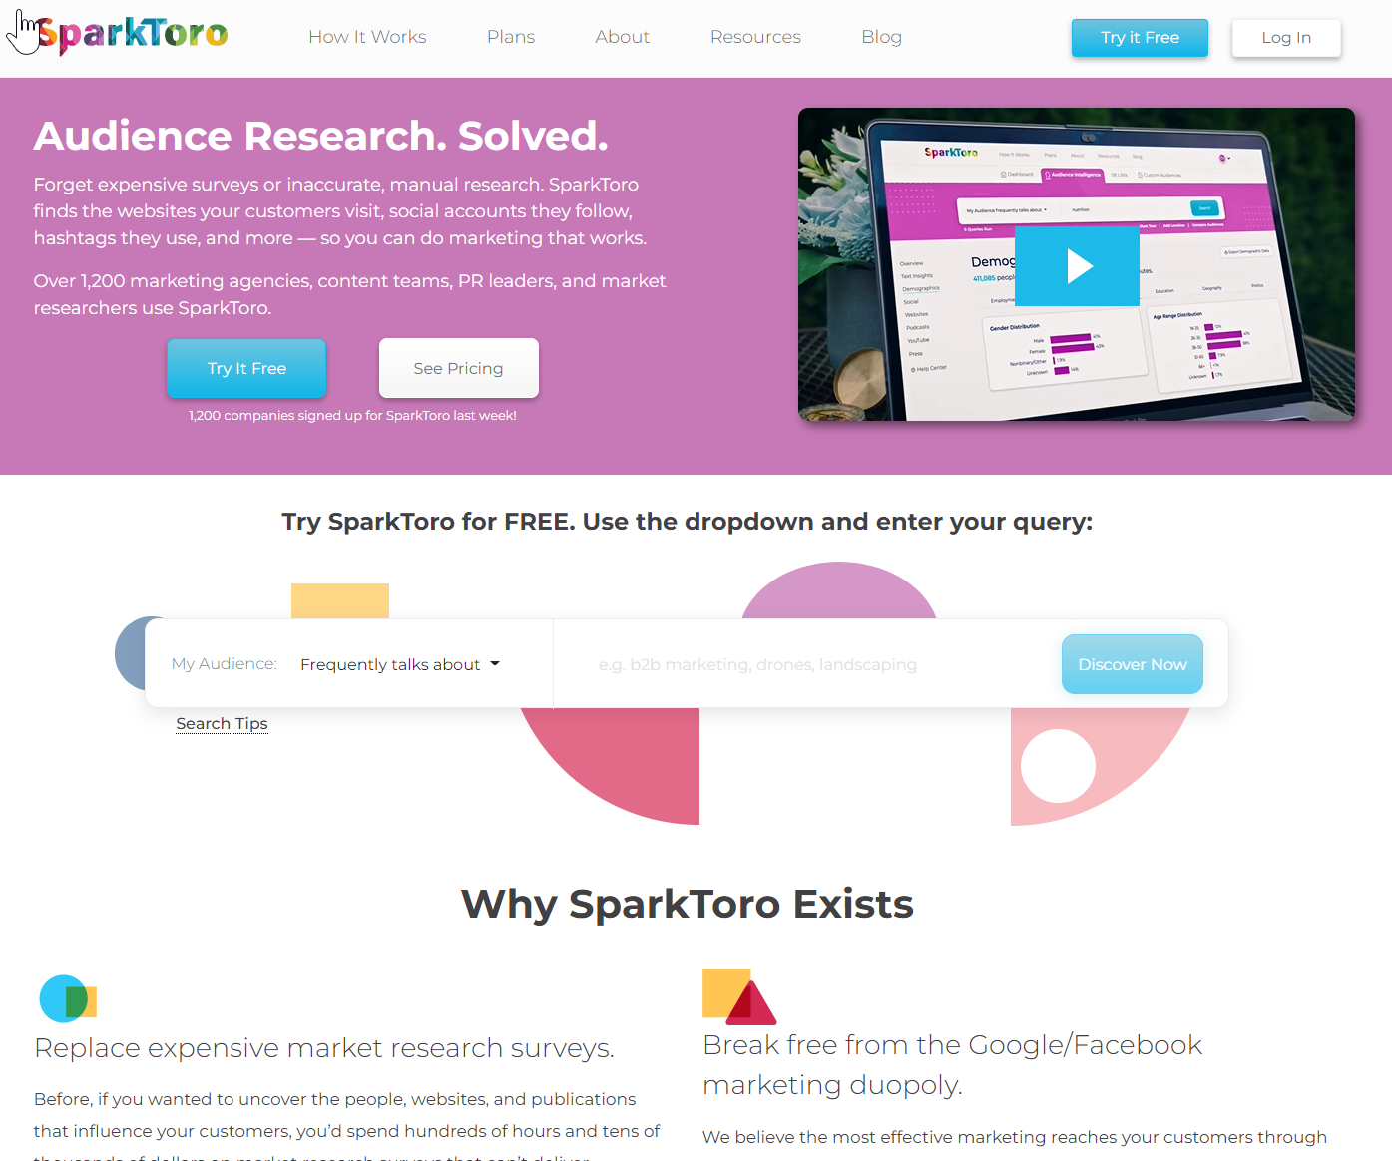
Sparktoro.com
Notes:
1:45 Sparktoro is actually a market research tool to help you discover what your targeted audiences are talking about, reading online, researching. It is a fantastic resource to see if what interests you aligns with what your audience is looking for.

Slide 20
Sparktoro.com
Notes:
Here is a quick run through of what sparktoro will tell you – for free. Obviously if you pay it tells you more but I often get along fine with the free version. Take a look.

Slide 21
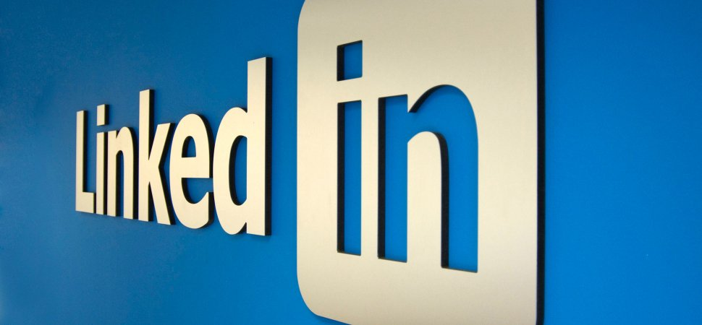
How to Brand Yourself as a Trusted Resource
Start on
This Photo by Unknown Author is licensed under CC BY-SA-NC
Notes:
1:50 There are a few ways you can brand yourself as a trusted resource but honestly, one of the easiest is to start with your presence on CLICK LinkedIN.
Why? Since 2019, LinkedIN has consistently been considered the #1 trusted network.

Slide 22
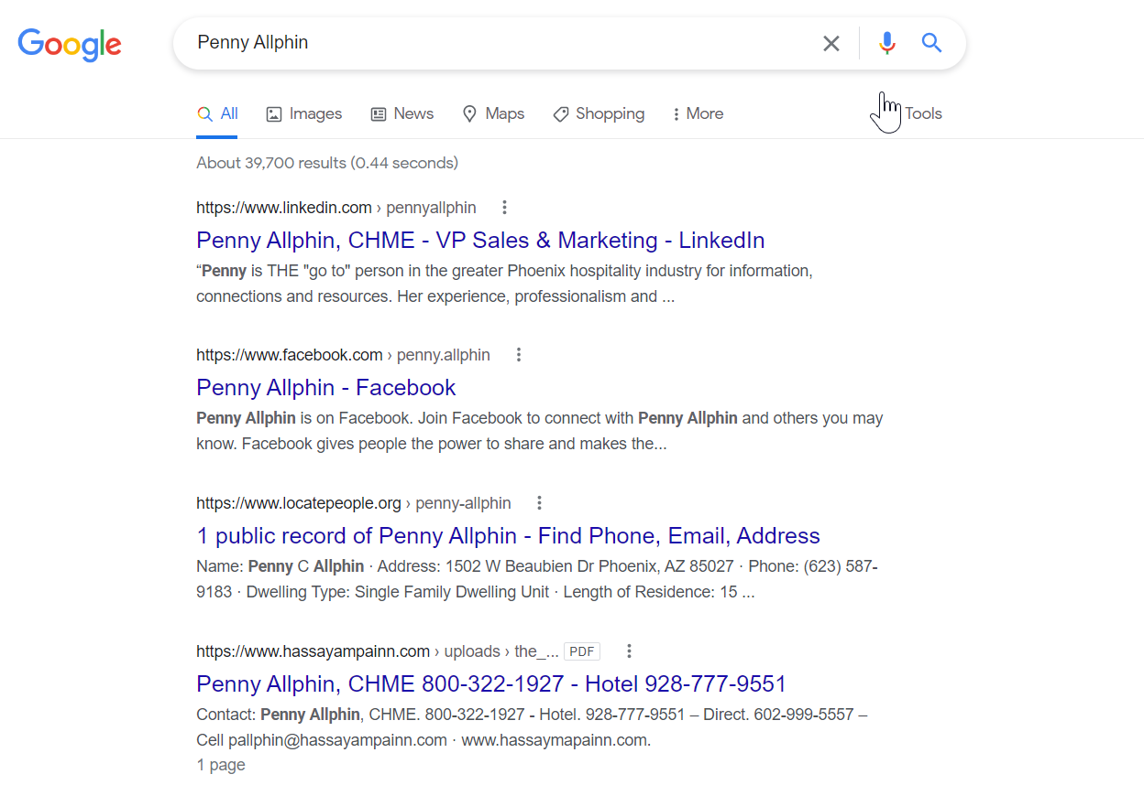
Why LinkedIn?
Notes:
Two Reasons. First, it carries a ton of clout on Google – and almost everyone looking you up will start on google. And my guess is, this won’t change any time soon because of reason #2 -

Slide 23
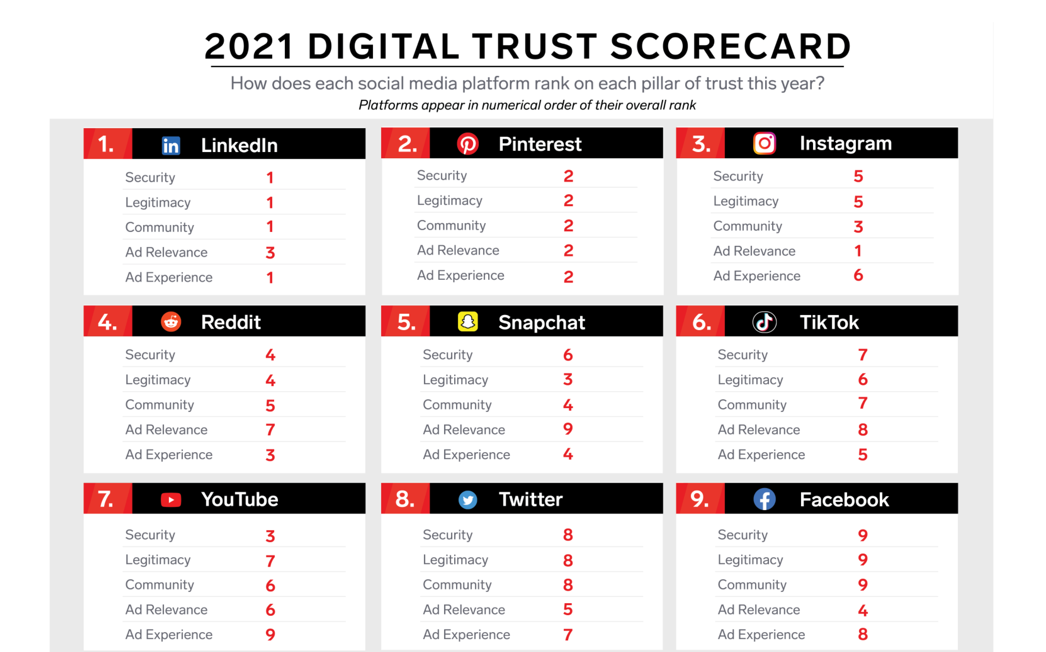
Source – Pew Research
Notes:
It ranks first consistently in both legitimacy and community and that matters to google a lot. If you want to be a trusted resource, you want to show up on a trusted network. However, LinkedIN isn’t the most used social network – it only has 33% of social media users. But what we have found is that the LinkedIn demographic favors a little bit older of a demographic, higher income – and most importantly, it is where decision makers go to get their business information. So now we are going to focus on the best ways to brand yourself on LInkedIn – 4 easy steps!

Slide 24
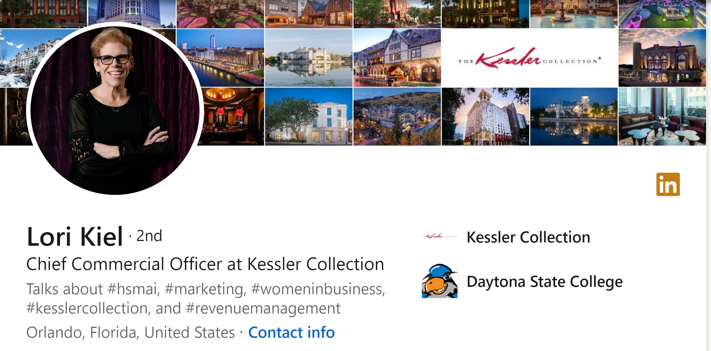
Like, Comment and Share
Create a TRP
Always Grow Your Network
Post Content of VALUE
Notes:
If you want to target corporate businesses, you want to follow these steps I outline on LinkedIn – because that is where our decision makers are. If you want to target leisure business, you want to apply these same principles to Instagram and Facebook. I suggest 4 simple steps.
Step 1 – create a TRP or trusted resource profile, step 2, like, share and comment on other people’s posts, step 3 post content that actually adds value for your audiences and step 4 grow your network – and I recommend that you consider video sales messanging to do this. I will do a slightly deeper dive on all 4 steps now

Slide 25
Create a TRP - Trusted Resource Profile
Notes:
To begin, you want to create a trusted resource profile. Thousands of decision makers are on linkedin, and when they come across your profile, you should be using the free advertising space to make a statement – this person is valuable, this person can be a trusted resource for you, the customer. They can help you solve a business problem. In every area of your profile, you should be asking two questions – does this convey me as a trusted resource? Am I speaking to my target audience about how I can be of help or value. LinkedIn was originally a place to find a job – so today, most profiles are written for a target audience of potential employers. You want to differentiate yourself by creating a TRP that speaks to your clients – to your target audience and I will share a few tips now on how to do that.

Slide 26
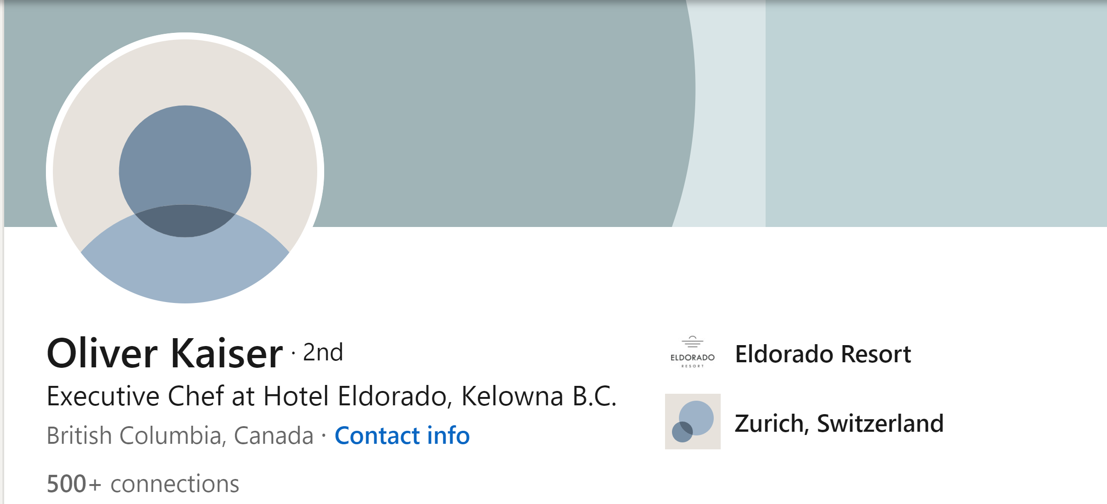
Compelling Background
Notes:
You have two opportunities to create your brand with photos. Most people will have a photo of themselves but leave the back with that blue LinkedIn design. This is free advertising space and a fantastic opportunity to start branding yourself as a trusted resource. This one gets the sad face. The back ground photo you choose should help to convey your brand – you as a trusted resource. Who are you? How can you help your audience?

Slide 27
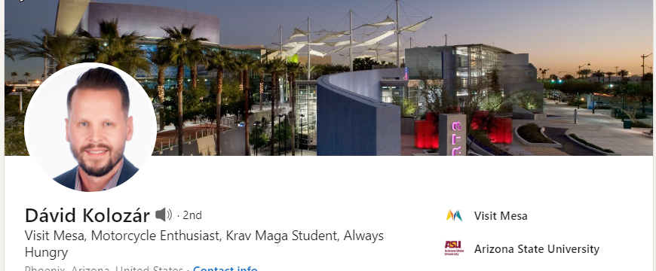
Compelling Background
Notes:
I searched everyone who’s name I could find affiliated with the group and this is on the of few who had an exciting background –w ell done. .

Slide 28
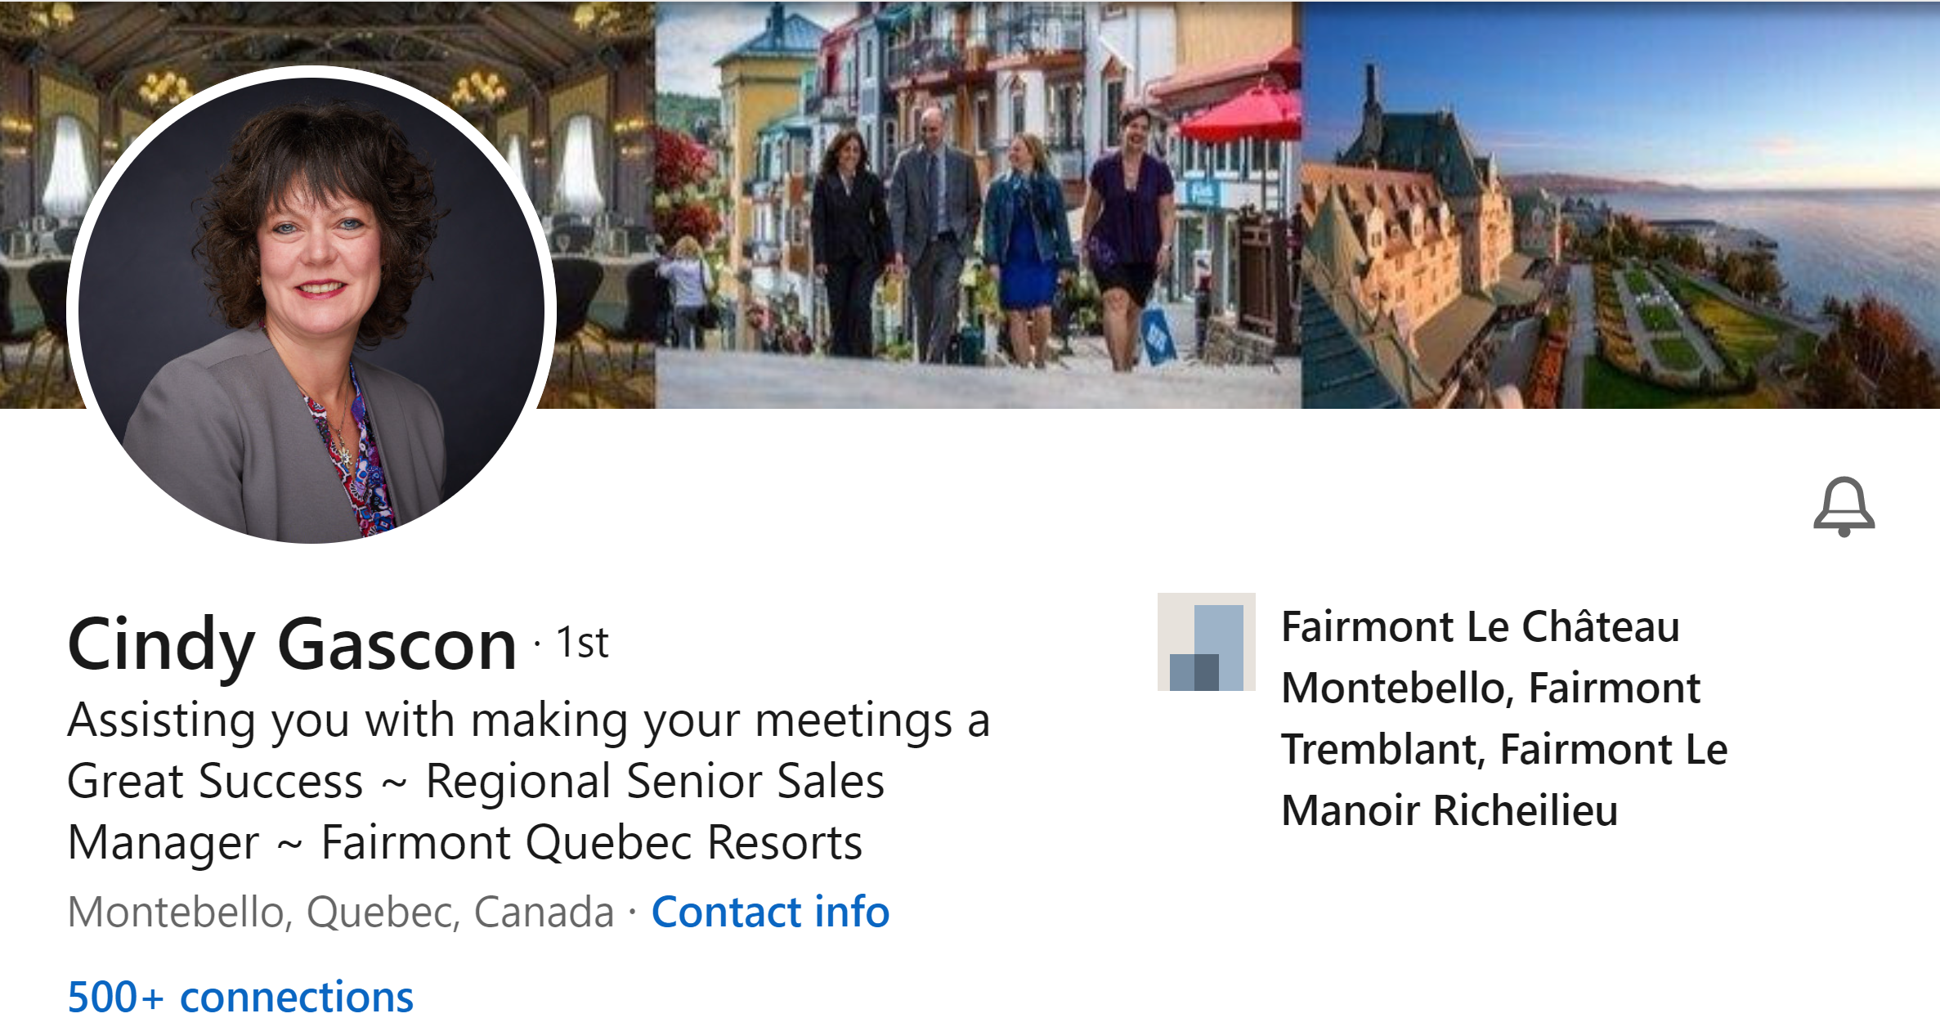
Compelling Background
Notes:
Cindy uses a professional photograph of herself, along with beautiful visuals of 3 properties she oversees. But what if you don’t have a beautiful product to showcase?

Slide 29
Compelling Background
Notes:
Ben uses a fantastic graphic to communicate his company’s value – digital without dishonesty – or digital with honesty. Striking and clever. All of these examples use the space to promote their brand.

Slide 30
A Headline That Helps
Notes:
LinkedIn refers to your title line as a headline – they want you to brand yourself. While titles are of course acceptable, what you really want to do is convey your value. I searched for assoc execs and these were my results – the generic assoc exec was most popular – and completely meaningless. At a minimum you should have your area of expertise. But I say go even further with your branding.

Slide 31
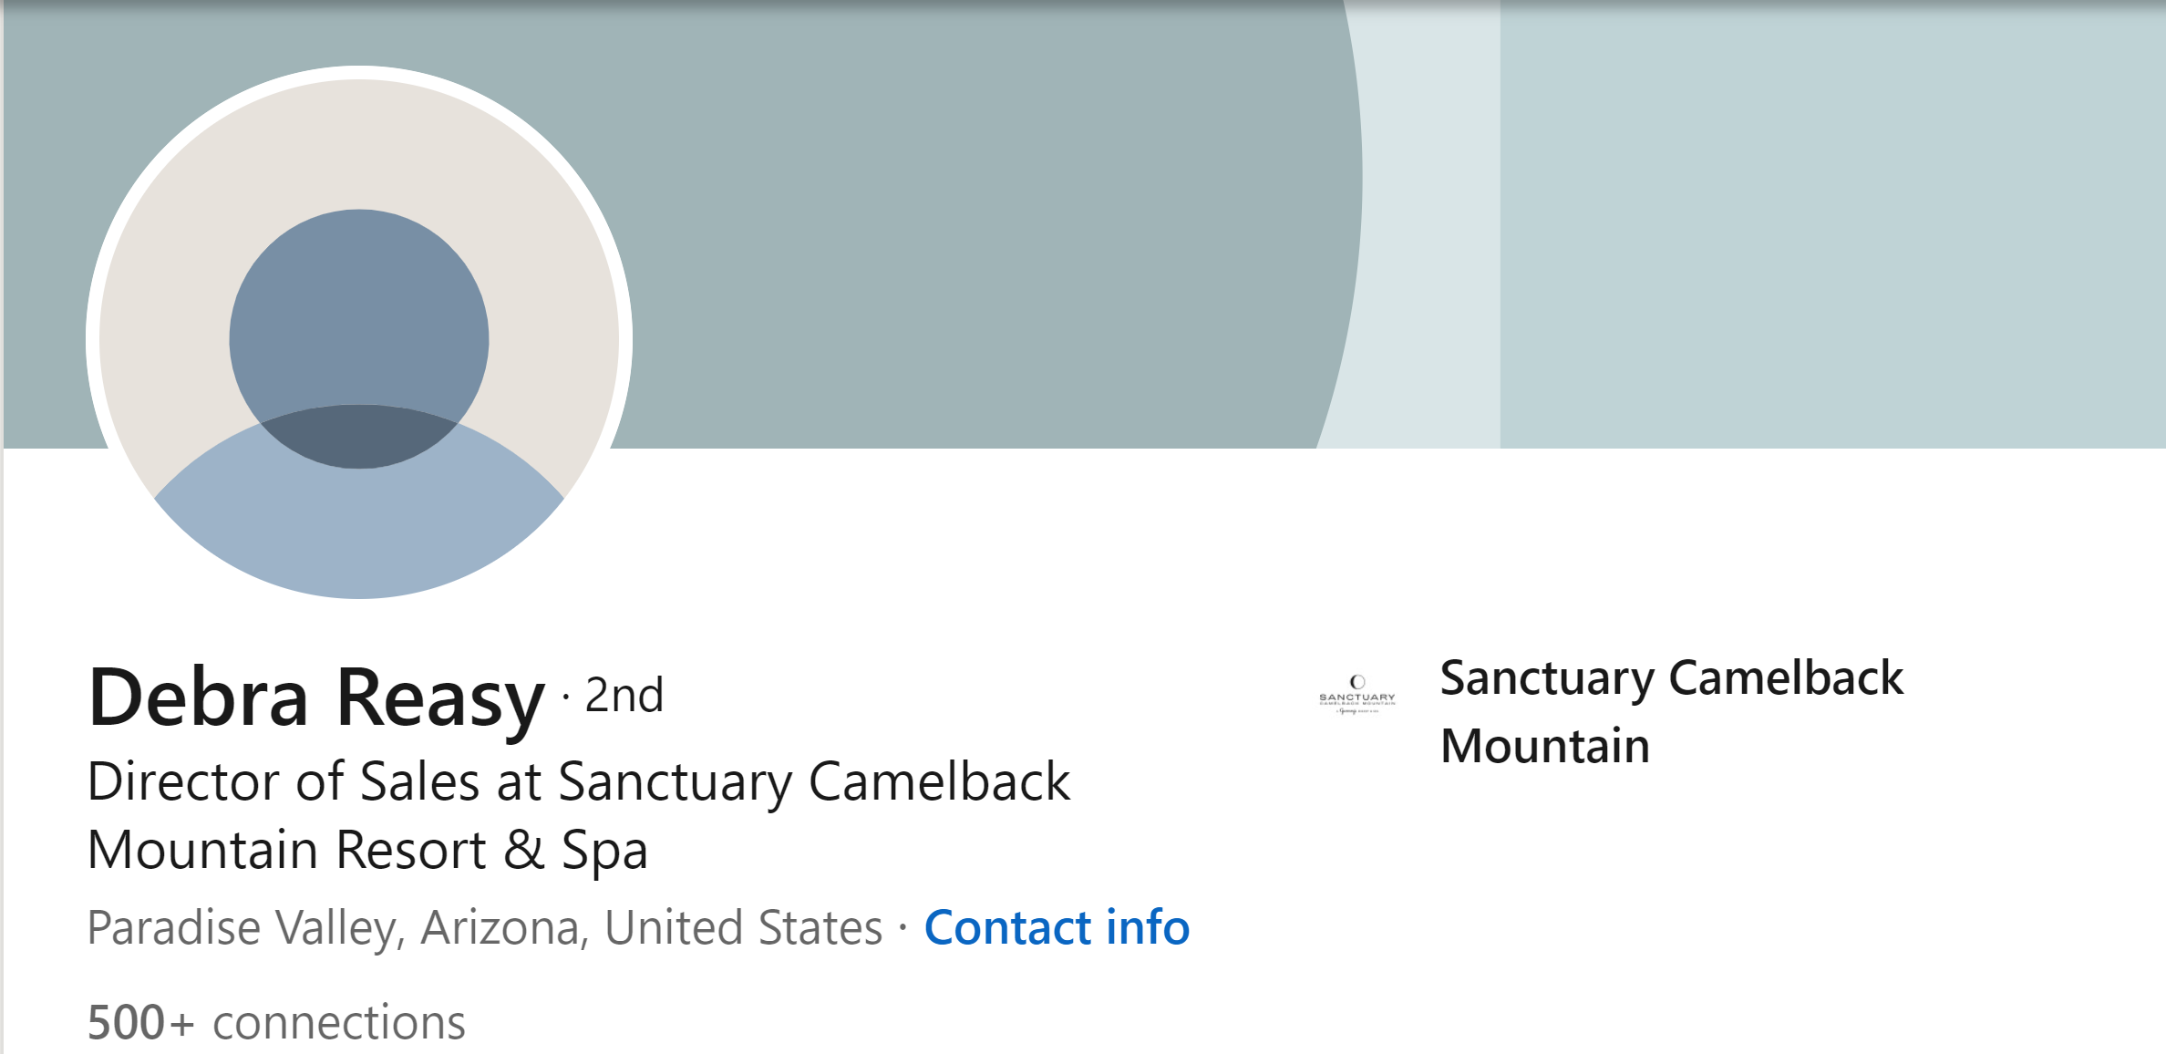
A Headline That Helps
Notes:
LinkedIn refers to your title line as a headline – they want you to brand yourself. While titles are of course acceptable, what you really want to do is convey your value. You are a trusted resource – how can you help your audience? Click - Pam has a hotel – obviously in Arizone – and she lets everyone know in her headline that she representes the largest AAA 5 Diamond luxry resort in AZ. Her title is there, but she is branding herself. Here is her competitor – what is her brand? Sorry Debra

Slide 32
A Headline That Helps
Notes:
Jennifer chose to be more descriptive in her headline – no title but it is clear how she can help you. Plan a conference – stress free. Just a note here about the headshot photo – this one is okay but it is clearly a selfie. I recommend a professional head shot – it is worth the small investment.

Slide 33
So Far - TRP
Photos That Support Your Brand
Professional Headshot
A background photo or text that conveys how you can help
Your headline
Why they should choose YOU to work with (hint –because you can help)
Notes:
2:15 Once you have created a trustred resource profile, it is time to expand your network. You should have a weekly goal of adding at least 25 connections to start. First invite everyone you already know to connect – definitely all past clients. Then get into the ha
bit of connecting with everyone you meet. Next, you are going to start to expand your network to people that you don’t know – but people who would surely benefit from getting to know you. And I have some advice about how to go about that too.
BREAK

Slide 34
I am a seasoned sales leader, and I always make my sales goals.
I have a passion for sales.
I am a dedicated leader and strategic thinker.
ABOUT
ME !!!!!!!
What Value Do You Bring?
Notes:
2:25 These three sentences are most typically found in the About section of a profile., This is your change to make a great impression, to really build your brand and what do most people choose to write – if anything?
Think about client biases – they just want to take my money. I always make my goals – they hear it as - they always take my money!
I have a passion for sales – oh they are going to talk a lot
3 – full of himself. Too clever for me.
ALL ABOUT THEM

Slide 35
ABOUT
What Value Do You Bring?
Notes:
In your about section, it is again your chance to engage your audience with the value you can bring to them. – here is a very simple example of an about section. The first paragraph is about what this person can do to help his clients. Then he has a sub head – HOW can I helo and he goes into alittle detail with some specifics. Finally, he wraps it all up with a call to action – if you are arranging travel accommodations, booking an event or you just want to learn more, let’s connect – and here is my email address. A call to action is why someone should connect with you and how.

Slide 36
ABOUT
What Value Do You Bring?
Notes:
here is another example and this person starts with a question that everyone fears – are you leaving money on the table? And then the rest of it is Cory walking you through, in short, compelling bursts, what he can do to help you. It is filled with stats and great information. That speaks to his audience.

Slide 37
About
Begin with YOU
Opening line – your differentiator
Clear, concise ways you can be a trusted resource
How your company can help
Again, some clear concise points around the value of your property – your differentiators - testimonials
Call to action – why and how
Contact me if….and here is how
Notes:
Once you have created a trustred resource profile, it is time to expand your network.Con You should have a weekly goal of adding at least 25 connections to start. First invite everyone you already know to connect – definitely all past clients. Then get into the habit of connecting with everyone you meet. Next, you are going to start to expand your network to people that you don’t know – but people who would surely benefit from getting to know you. And I have some advice about how to go about that too.
Activity time – take a minute, write two lines of your about you – first line – how you can add value. Write down 5 lines fast. Take 4 minutes to write 5 lines. Not looking for perfection. Just brainstorm 5 maybes.
Pass it to the person to your right. You read all 5, choose your favorite and edit it to make it better.
Call on volunteers to read theirs. Discuss.

Slide 38
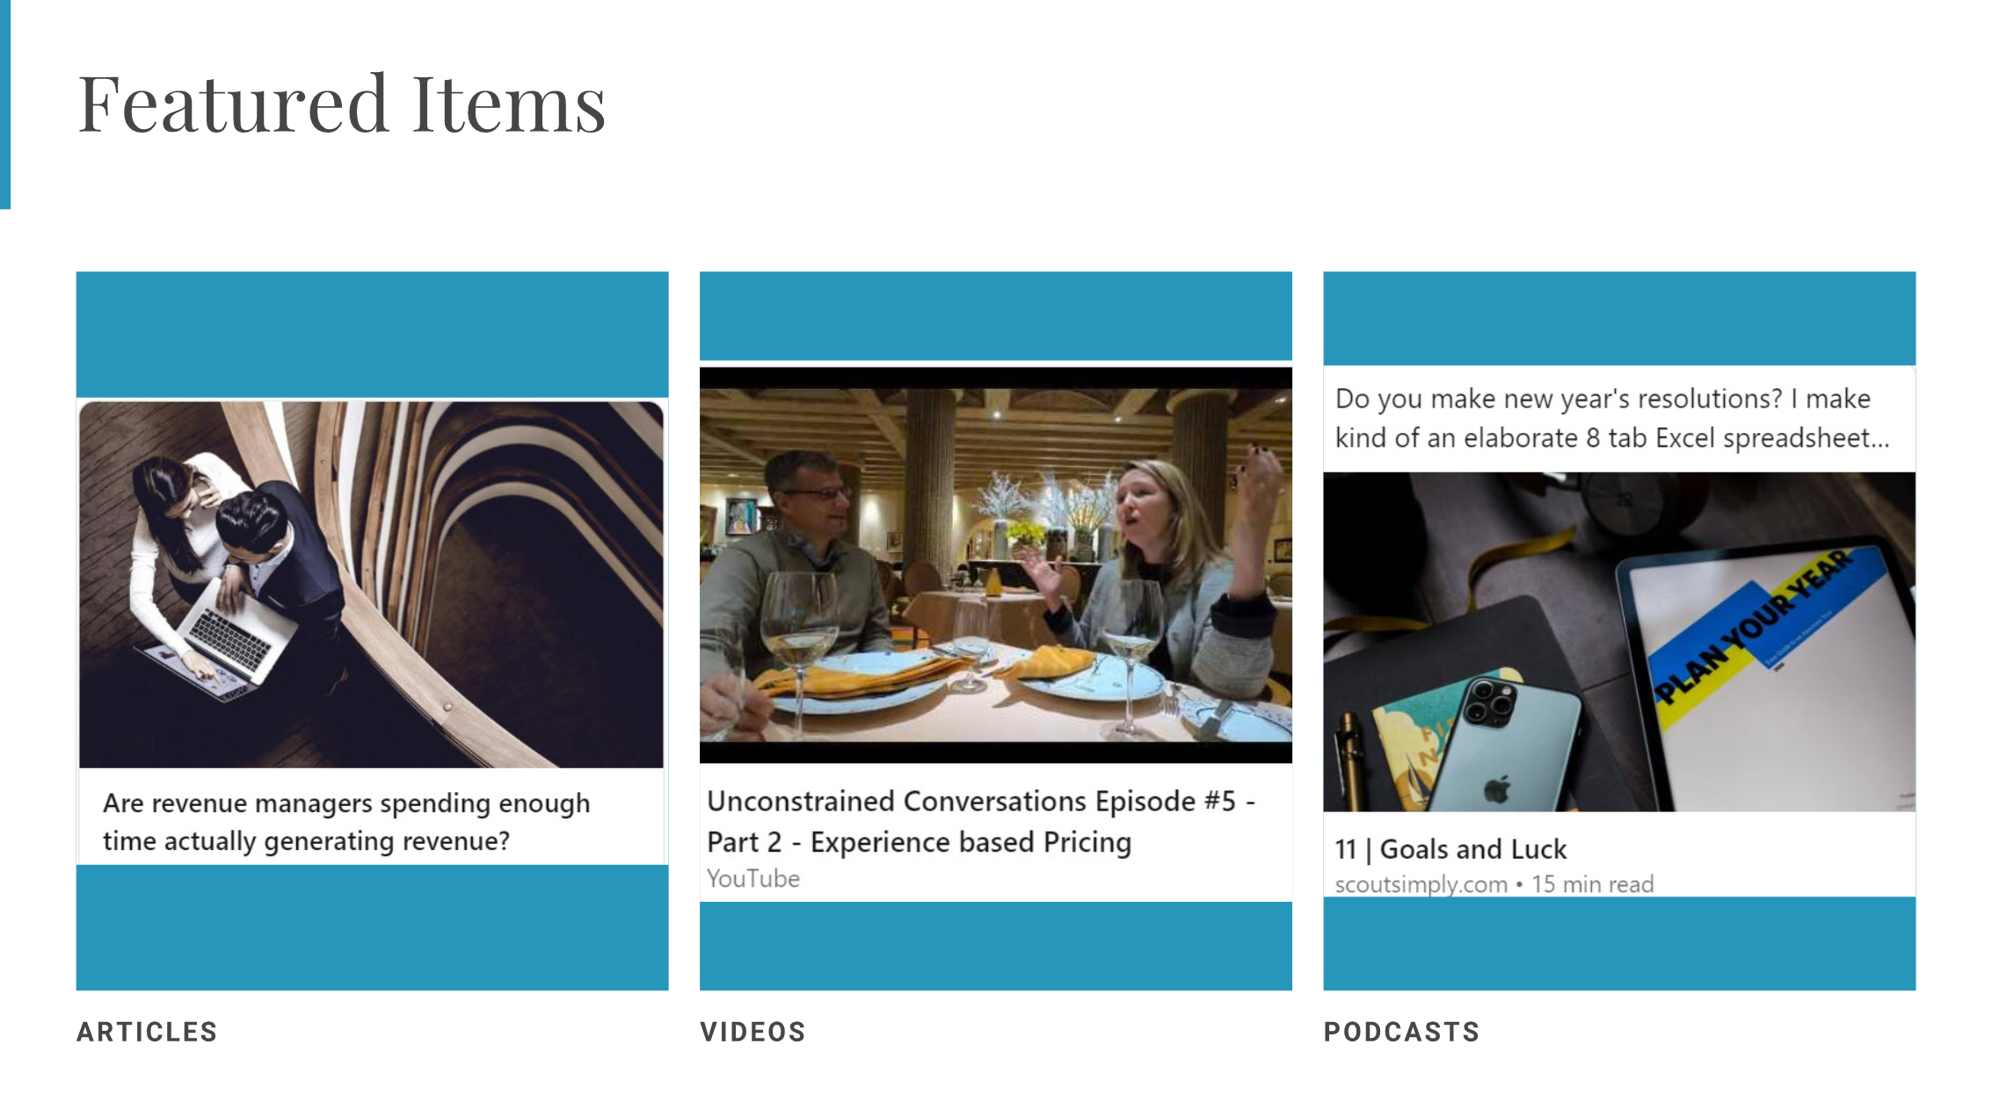
Notes:
2:45 You are able to add multiple types of media to your profile in the Features section. You can add articles, videos, podcasts, posts or images – any content that can add value for your readers and continue to position your sellers as a trusted resource. Don’t waste this valuable real estate with nothing!

Slide 39
Features
Notes:
You are able to add multiple types of media to your profile in the Features section. You can add articles, videos, podcasts, posts or images – any content that can add value for your readers and continue to position your sellers as a trusted resource. Don’t waste this valuable real estate with nothing!
Those a just a few high level pointers on creater your trusted resource profile. There are more things that you can do – like getting clients to write you linkedin recommendations – but these tips are the must dos to get you started. One piece of advice I have for you is to just do it – don’t strive for perfection because you will never get it done. Make some updates, you can always go back and edit them. I also HIGHLY recommend that you ask for feedback from coworkers and ideally a customer or two.

Slide 40
Recommendations – Awards
Ask for a recommendation – from clients
Make it easy – give them tips that you want to highlight
Add any honors or awards
For you and for your property
Notes:
Finally you want to make sure that you have some recommendations – from clients. The best way to get recommendations is to give them – and then ask for them. Make it easy for people to know what to say by giving them some bullet points. Incorporate your value. They will appreciate it.
Finally – in the honors and awards sections, make sure you list ANYTHING that either you or your property have won. It goes toward credibility and trust.

Slide 41
TRP Checklist
Background photos that help
Engaging headline
An About section that tells about how YOU and your company can help – with a call to action
Featured Items that invite and intrigue – and further showcase how YOU and your product can help
Recommendations about HOW you have already helped.
Honors or Awards (you AND your property)

Slide 42
GROW YOUR NETWORK
Invite EVERYONE you know
Past clients
Everyone you meet
Invite those who would benefit from knowing you!
From your LinkedIn leads list
From your CVB leads list
Notes:
Once you have created a trustred resource profile, it is time to expand your network. You should have a weekly goal of adding at least 25 connections to start. First invite everyone you already know to connect – definitely all past clients. Then get into the habit of connecting with everyone you meet. Next, you are going to start to expand your network to people that you don’t know – but people who would surely benefit from getting to know you. And I have some advice about how to go about that too.

Slide 43
4 Easy Steps to Connect with Future Customers
1 - Look at THEIR profile
2 - Like their stuff
3 - Send a connection request
4 - Add a note – don’t be a pesky salesperson
MUTUALLY BENEFICIAL
No ideas?
I thought it would be to our mutual advantage to connect.
Notes:
I pretty consistently follow these 4 steps. First, look at their profile. They will get notified that you are looking at their profile – and that is a good thing. They will see your name. Second, start to like and comment on their posts. Again, they will get notified and see your name. Next , send a connection request – this will be the 3rd time they see your name. And finally, add a note. Often they may not see this note until after they have accepted your connection request – so you just want to tell them why it is mutually beneficial for you to connect. I try to reference commong groups we belong to, common people know – whatever reason they might see for wanting to connect with me. I keep it short and NO selling! Worst case scenario I write one line – I thought it would be to our mutual advantage to connect. And THAT Is it! Plus a thank you at the end. It is as simpe as that. But it will be the 4th time they have seen your name. Now they “know” you.

Slide 44
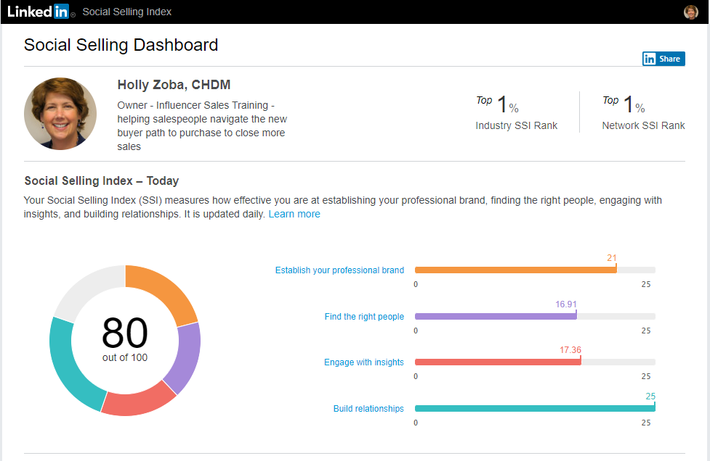
Linkedin.com/sales/ssi

Slide 45
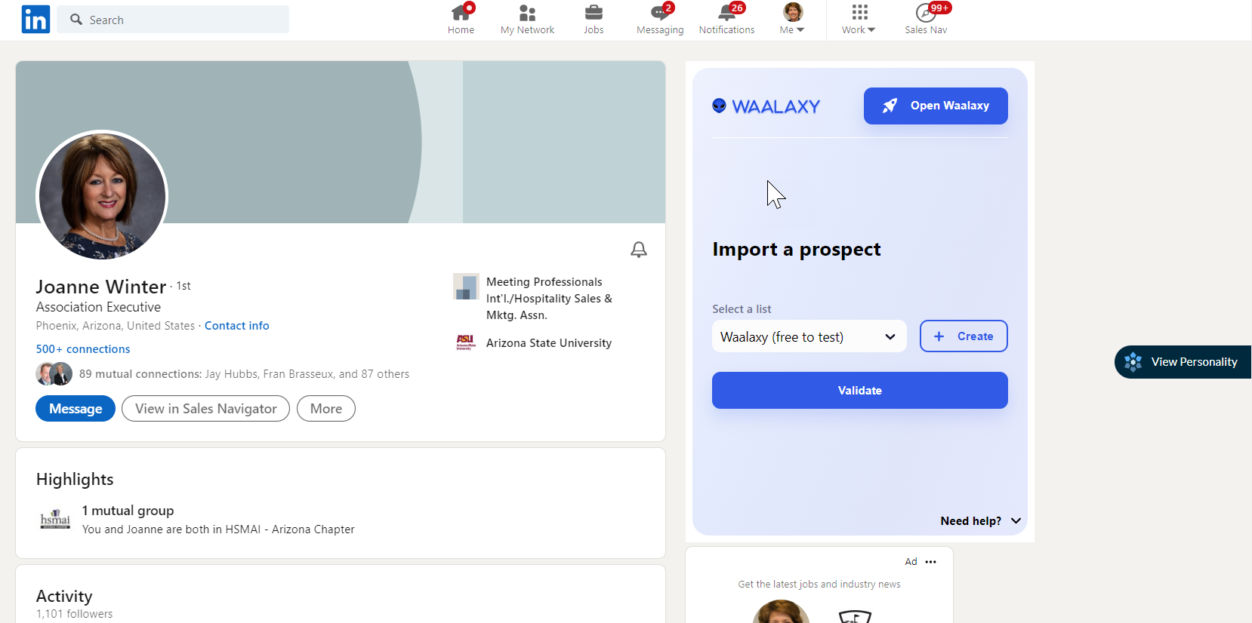
Meet Crystal Knows
Notes:
Time for an app.

Slide 46
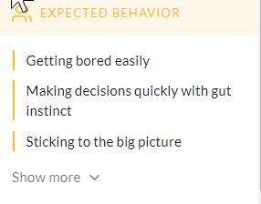
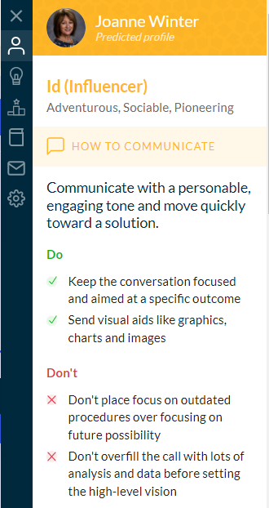
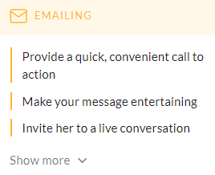
Meet Crystal Knows

Slide 47
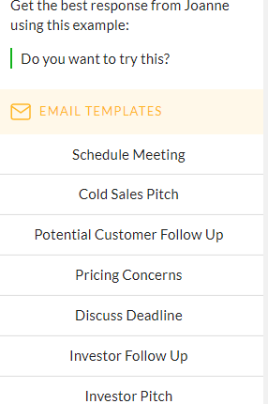
Meet Crystal Knows

Slide 48
Like, Share and Comment
Notes:
3 Step Two is to like, share and comment on other people’s posts – specifically your customers. Because when it comes to social media, we are all insecure high school girls and getting likes and shares matters. When people see that you read their post and took the time to comment, you become a favorite of thiers. It is just human nature. So don’t be so stingy with your likes and comments. And don’t just like - actually take a minute and write a comment. Thanks for sharing this article – it was a good read and I learned XYZ. They will appreciate you.

Slide 49
Remember
What you like, comment and share on
sends a message about what is important to you.
Be specific about what you like about it.
“Great job!
“Great job creating such a memorable experience for our guests!

Slide 50
Post content worth talking about.
2021 LinkedIn Algorithms
Notes:
Step three is to post post valuable content – that is worth talking about. Not for your peers – not for others in the hotel business, but for your customer's and potential customers. And this is important - LinkedIn Algorhythms prioritize engagement. You will get better exposure if your posts are commented on so when you are writing your posts, keep this in mind.

Slide 51
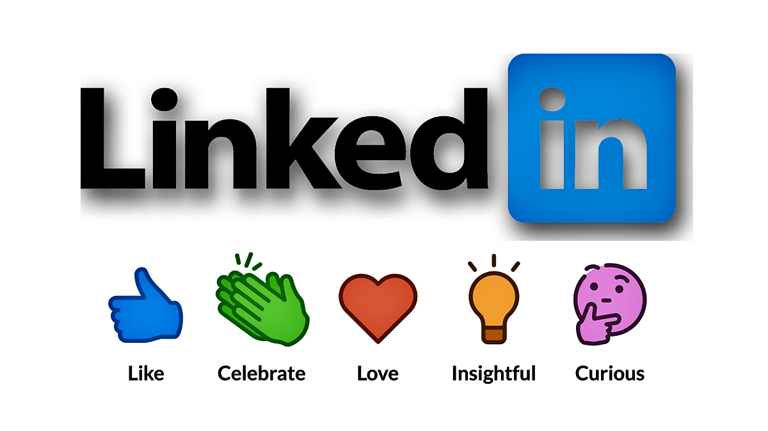
2021
This Photo by Unknown Author is licensed under CC BY-NC-ND
Notes:
Here are more of the LinkedIn algorithms for 2021. and it is a continuation of getting people to like, share and most importantly comment on YOUR posts. And LinkedIn is looking for real engagement – lengthy comments over only lots of likes so keep that in mind. You can see here – your business page post gets less traction than if you share your business page post. So think about all of the content that Best Western shares – you can simply reshare that content – AS LONG AS IT has value to your audience. You can also post on your own business page in LinkedIn, and then share that content on your newsfeed. Here are some samples.

Slide 52
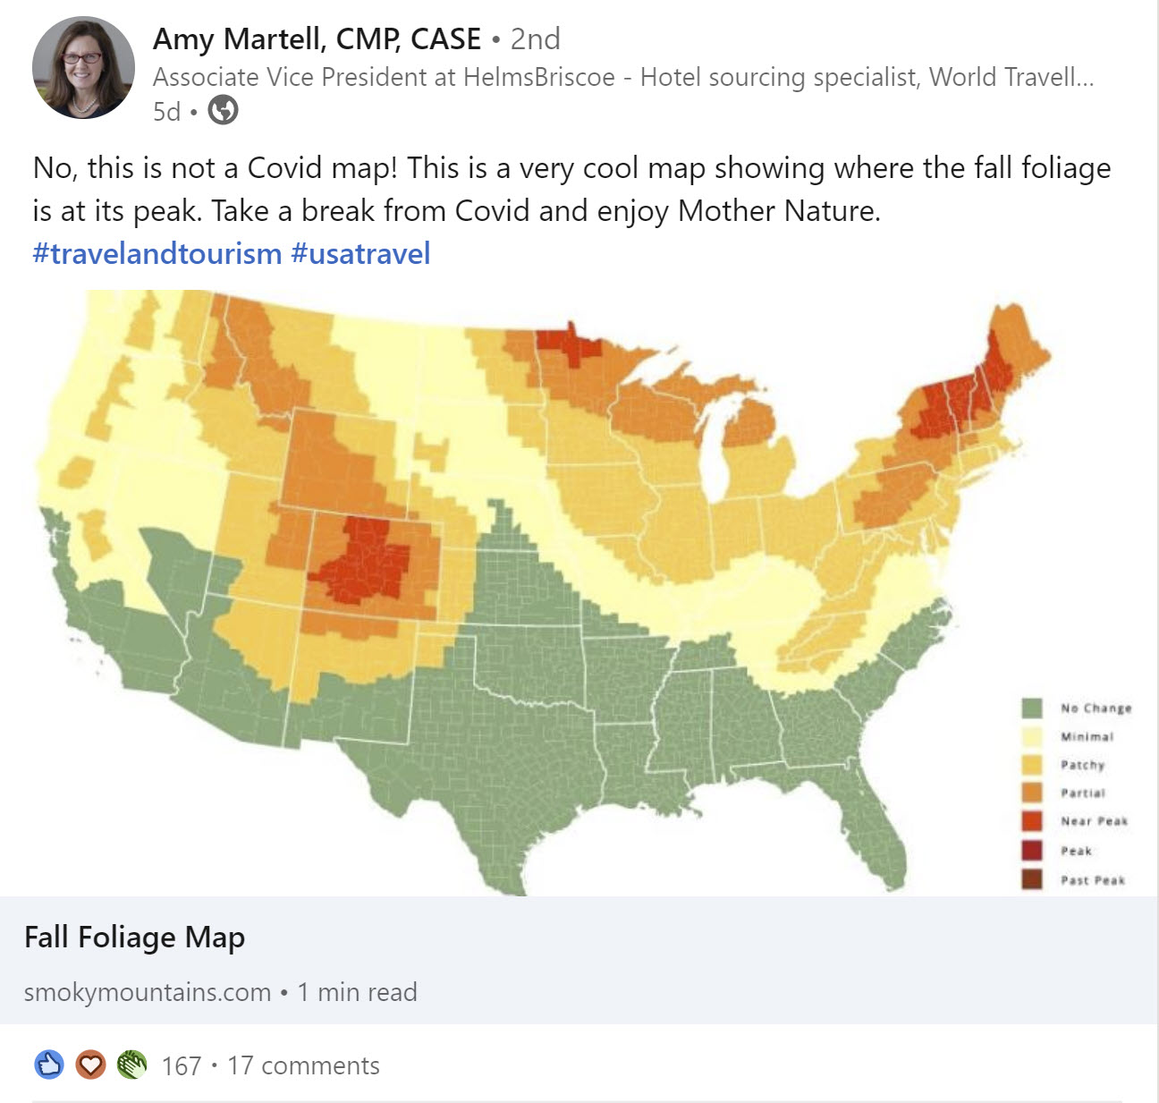
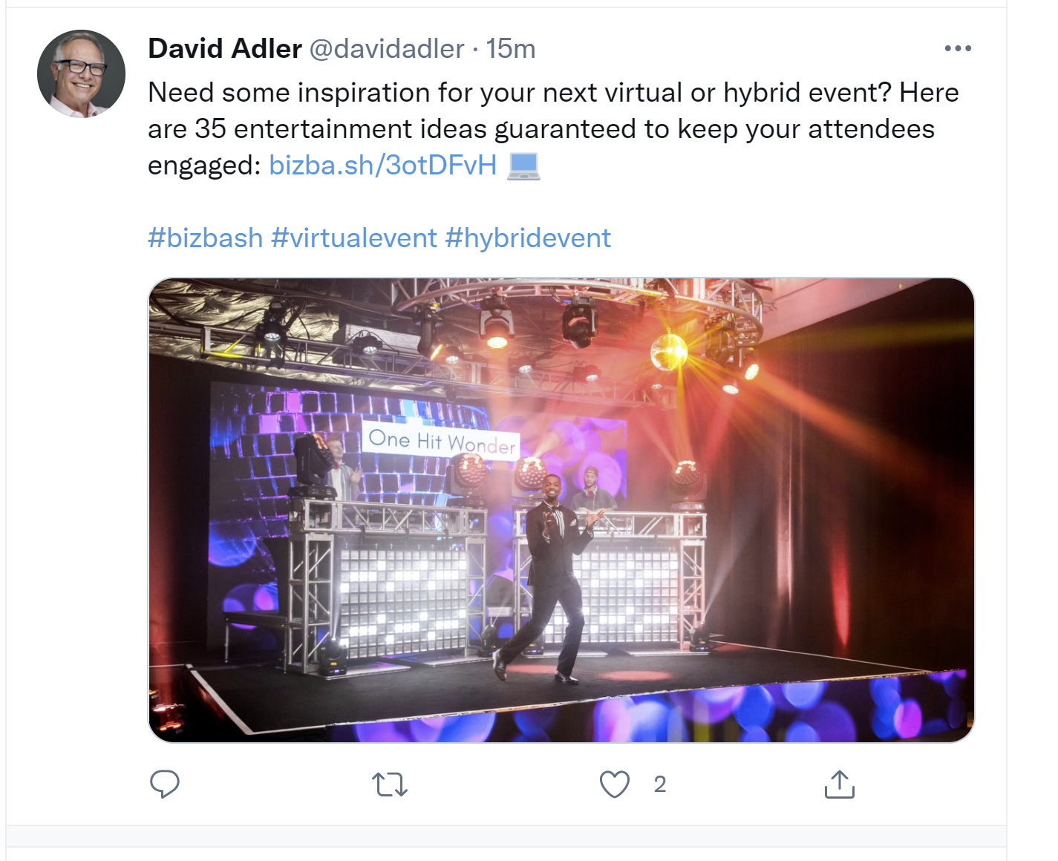
Notes:
Amy got a lot of reactions AND 17 comments because she posted – and gave a written compelling intro – about fall foliage and when it peaks. David shared an article that meeting planners will want to know about – 35 ideas to entertain and engage your attendees

Slide 53
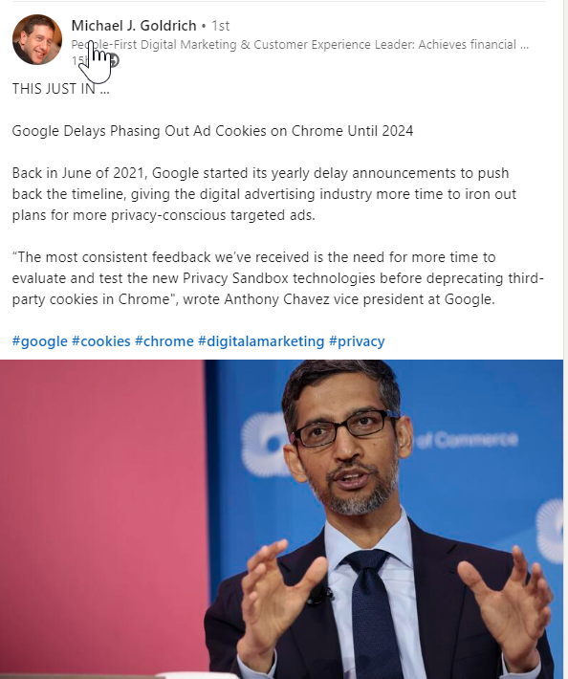
Notes:
Michael Goldrich posts something that every digital marketer wants to know – google is postpoining phasing out ad cookies.

Slide 54
Treat Your Posts and Messages Like a Paid Ad
“You as trusted resource” is the brand.
Captivating headline
Speak directly to your audience
FOMO, Curiousity, Pain Point
Engaging content
Relevant FOR THEM
Add value
Notes:
Here is something I will never understand. If we had to pay to post something on LinkedIn, we would probably get marketing involved or at least spend some time getting the headline and visuals right. But because it is free, we either post nothing, OR, post boring, often self serving all about me no value for our customers ramblings. We need to start treating these posts as an opportunity. We are creating awareness of us, as valuable resources – this is a branding tool. So treat it like you would a paid ad. But YOU are the product. Your prospects perception of YOU.

Slide 55
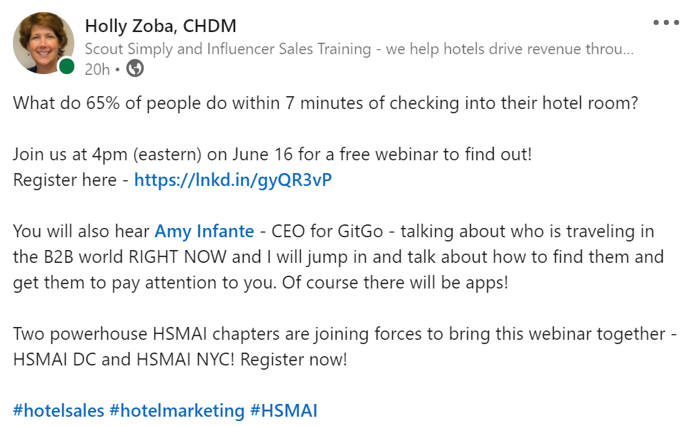
Notes:
This is the post that I shared on LinkedIn about a webinar I gave recently. I used a curiousity headline to get attention. My audience is hoteliers and I have tested this question before, hotel people HAVE to know the answer to this question. Any guesses to the answer?– put it in the chatbox. You may also note I didn’t use any visuals. LinkedIn is a funny platform in that their algorithms seems to reward text over images so I was testing reach with no image added here and In truth, I was very rushed when I posted this and I skipped 3 key elements. A trackable link, emojiiis and I should have encourage people to guess the answer in the comments. But those are all topics for another webinar. Oh – the answer is they log on to the internet. Because we live in a digital world.

Slide 56
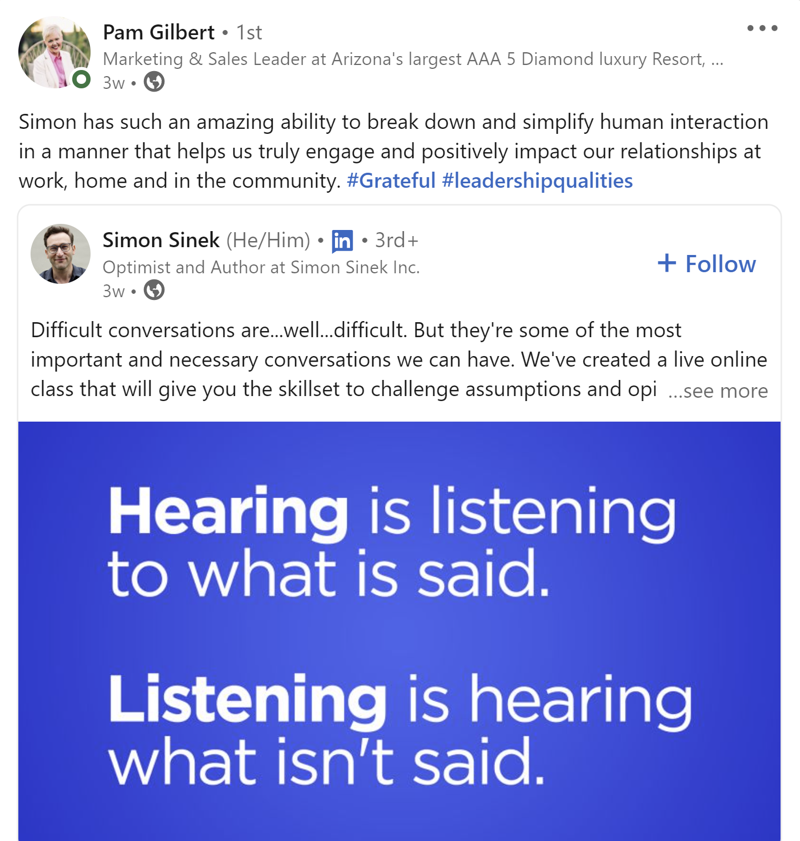
Sharing valuable content to help your clients be successful.
Notes:
And here is Pam sharing content around having difficult conversations. Of course she also posts content around her hotel – but she definitely follows the 4-1-1 rule – 4 posts that educate and inform, 1 soft sell, 1 direct sell. .Also one comment on social media Algorithms. They are looking for engagement – the more people who like, share or comment on your posts, the more often the social platform will put your post at the top of the newsfeed. So when you are sharing information – ask people to share. Ask questions to get them to engage. Imagine if your manufacturing prospect shared some content that you shared – you will be in front of all of their contacts now.

Slide 57
4-1-1
4
Educational
Inspirational
1
Soft Sell
1
Hard Sell
Fun
Notes:
And this is what I would consider a soft sell post – Marletta is promoting the hit the road package her company is offering – but she gives it a great intro by asking the questions – are you ready for a road trip? Very relevant headline that resonates.
Don’t think I am suggesting that you no longer send prospecting emails, or make prospecting phone calls – I am just suggesting that you add sharing content to position yourself as a trusted resource when you do. Sharing on linkedin and being seen is a bit like sending hundreds of prospecting emails all at once. But you still want to reach out via email or LinkedIn messaging.

Slide 58
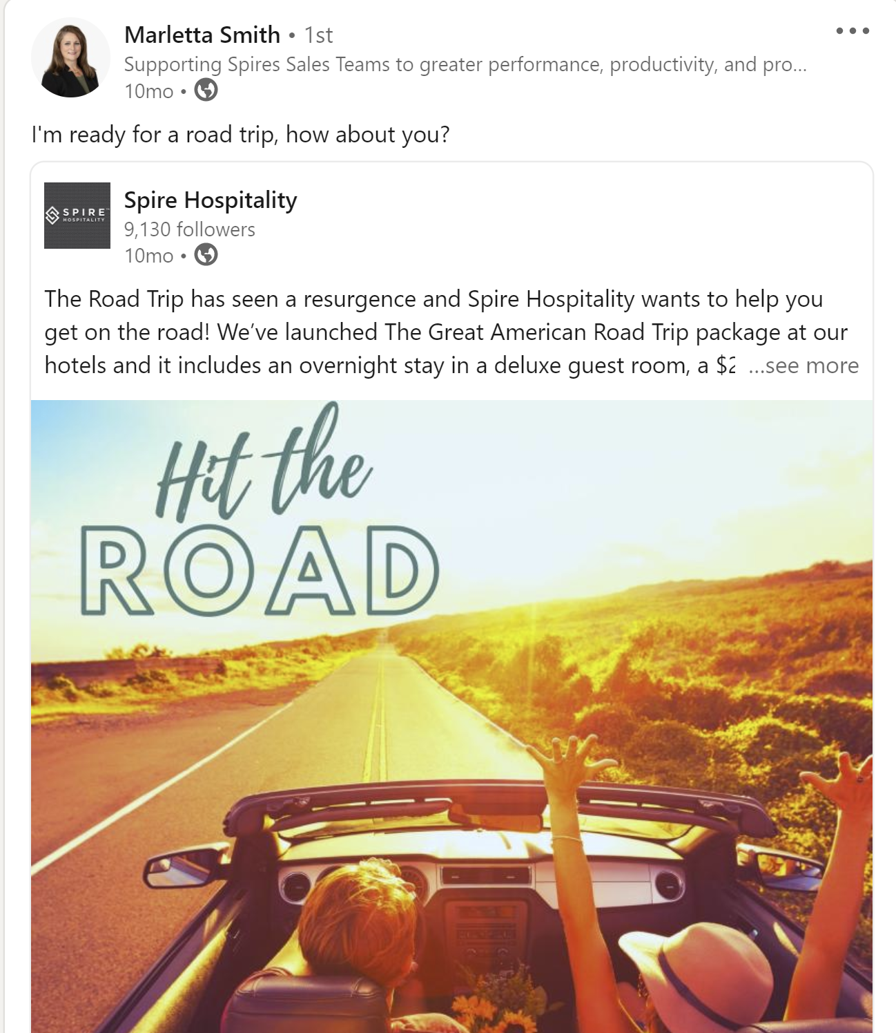
Soft Sell Sample
Notes:
And this is what I would consider a soft sell post – Marletta is promoting the hit the road package her company is offering – but she gives it a great intro by asking the questions – are you ready for a road trip? Very relevant headline that resonates.
Don’t think I am suggesting that you no longer send prospecting emails, or make prospecting phone calls – I am just suggesting that you add sharing content to position yourself as a trusted resource when you do. Sharing on linkedin and being seen is a bit like sending hundreds of prospecting emails all at once. But you still want to reach out via email or LinkedIn messaging.

Slide 59
How to find valuable content?
Notes:
You might be wondering to yourself, how do I find valuable content? And I hope you are asking yourself that because if valuable content was easy to find, everyone would be doing it. It takes a little bit of knowledge about your client’s interests to determine what content is worth sharing.

Slide 60
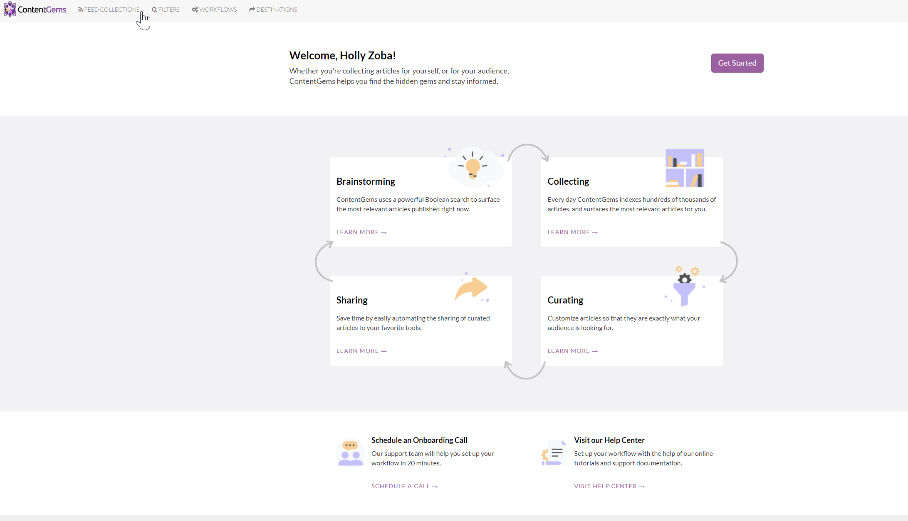
Contentgems.com
Notes:
I am also a big fan of an app called contentgems. You can search for articles by content – but you can also set up some filters so that once a week you get an email with a collection of articles that might interest you. It saves me time and it is always a good reminder to share some good content when I get that email.

Slide 61
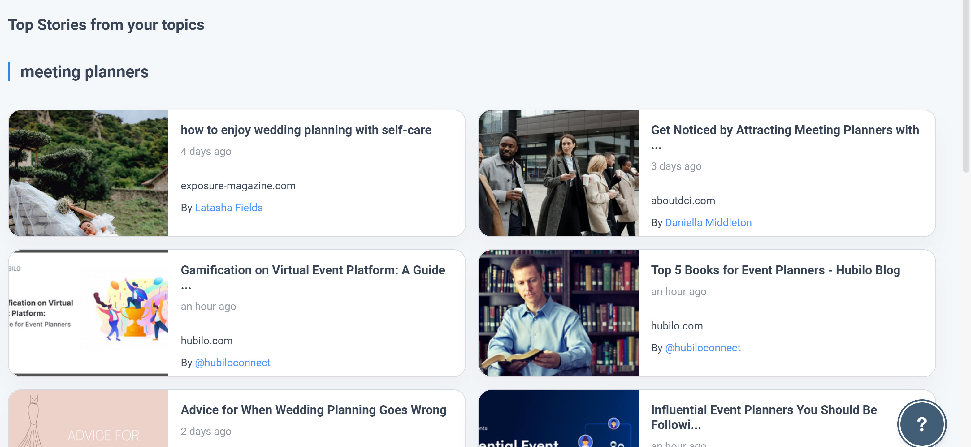
Meet ContentStudio.io
Notes:
How can you find content that is valuable to your audience? Sparktoro is a great place to start – you can go to Spark and discover keywords that your audience is talking about. Then you can google and see what happens or you can use an app I like called Content Studio . Io This app is helpful for finding, scheduling and posting content. Here is a very quick demo of how you might use it.

Slide 62
ContentStudio.io Demo
Notes:
There are a lot of content providers out there and I have investigated many. Buzzsumo is probably my favorite, but it is now about $99 a month for a subscription and it is a little less user friendly. I personally switched to ContentStudio as it is less expensive and really fast and simple – and honestly, it has returned the best content ideas. If you serve multiple audiences, you can add more topics. When you log on a 2nd time, it pulls the most popular content from each of your topics automatically which makes it even faster and easier to share good content.
Big warning – ALWAYS read the whole article! In my demo, I skimmed the article – don’t do that in real life! You want to make sure you are sharing content of value, and if the article is pointless or confusing, you will not help your thought leader brand at all. So make you you do read the articles thoroughly before you decide to share.
Content Studtio also has a tracking dashboard, so you can see how much engagement you are getting from the content you are sharing.

Slide 63
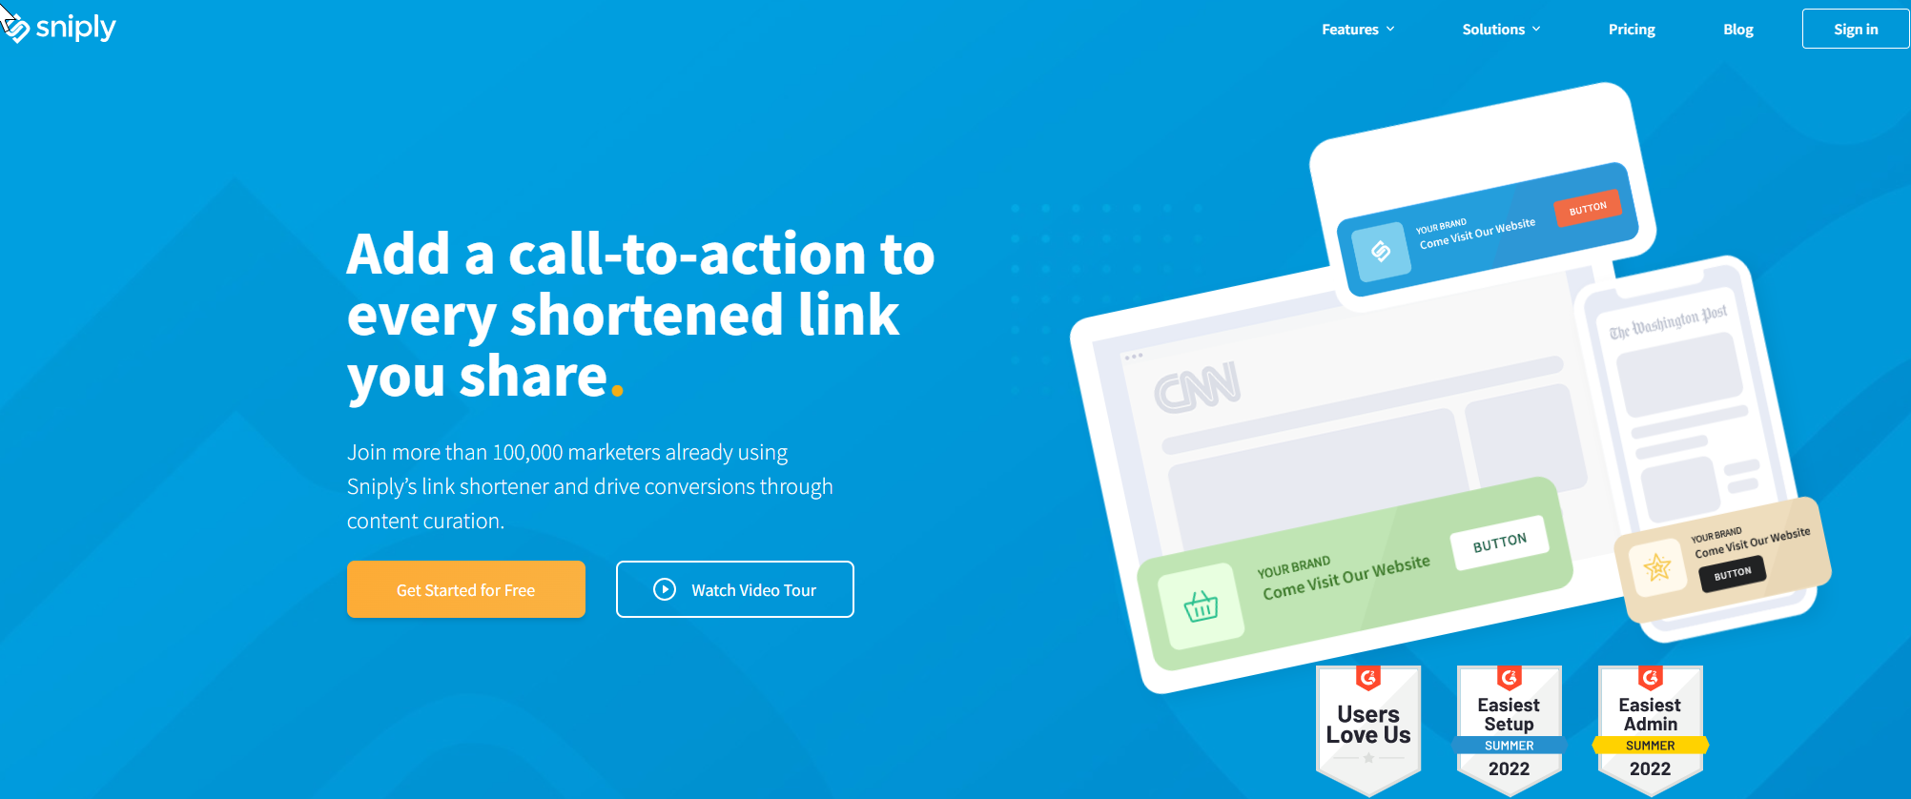
Meet Snip.ly
Snip.ly is a code that you create whenever you want to share an article or video.
.
The code allows you to share the article (or video) but places a little snipped at the bottom of the page for you to personalize, with a CTA – call to action – to a landing page, website, or anywhere you want to send your client.next
Page 21
Notes:
50

Slide 64
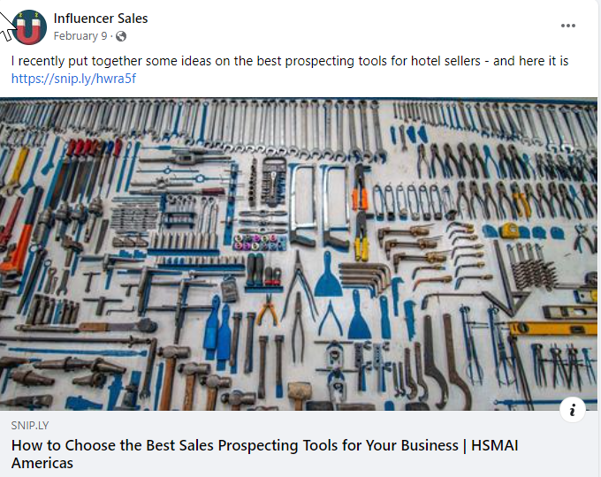
Looks like any post
But there is a snip.ly link

Slide 65
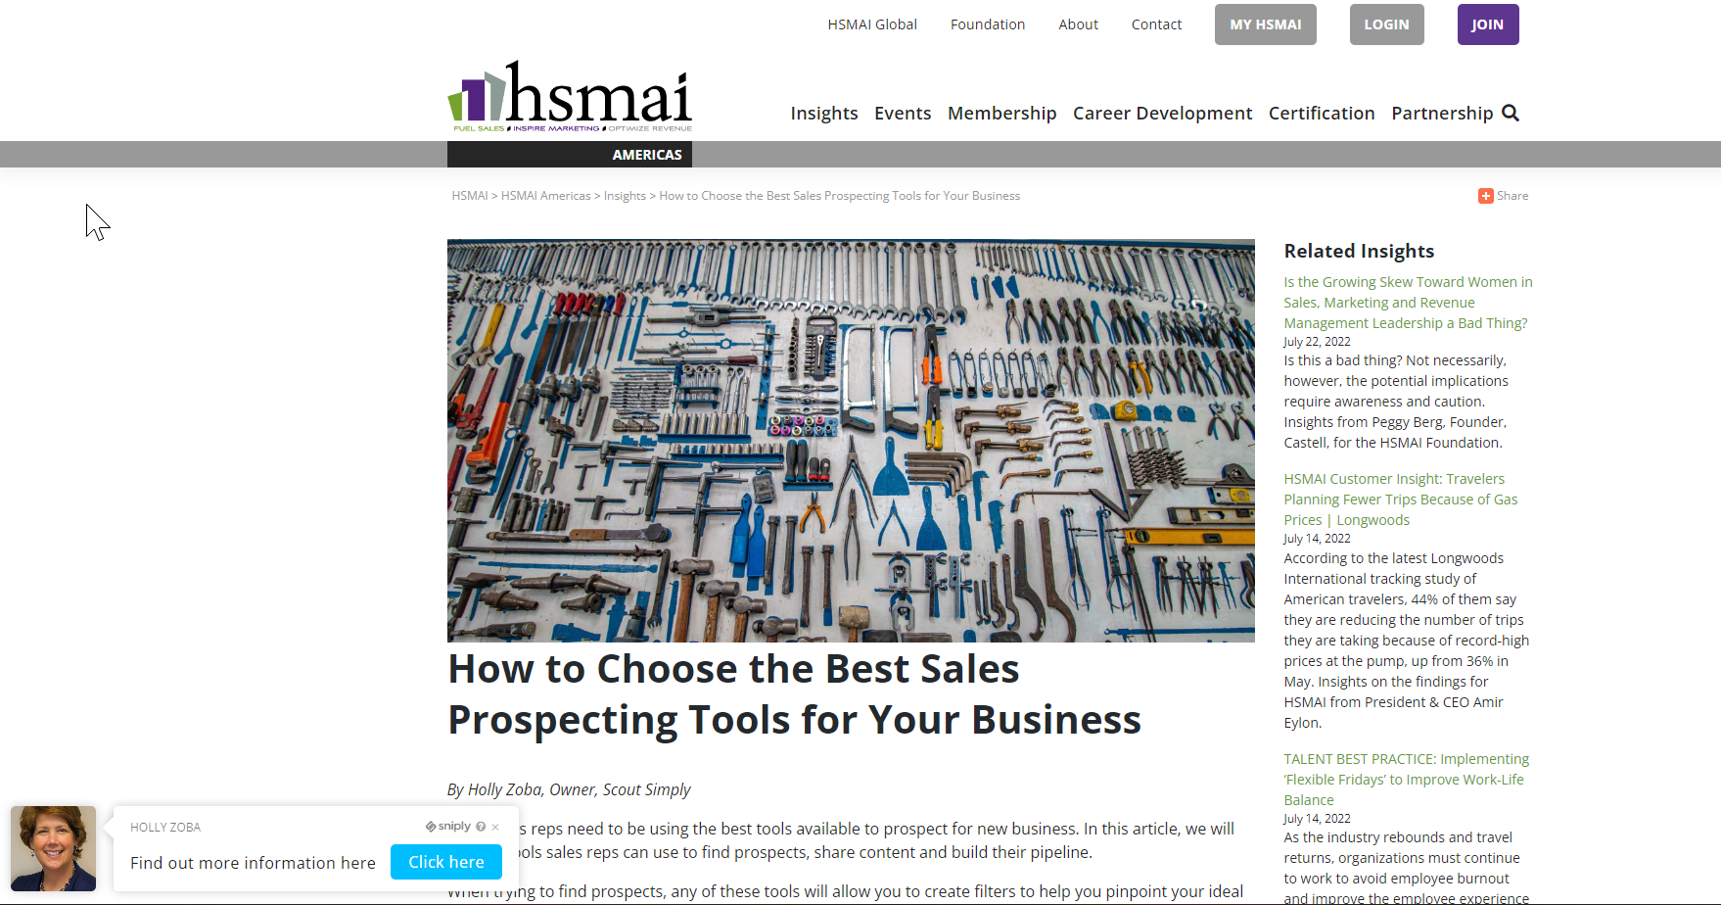
Notes:
51

Slide 66
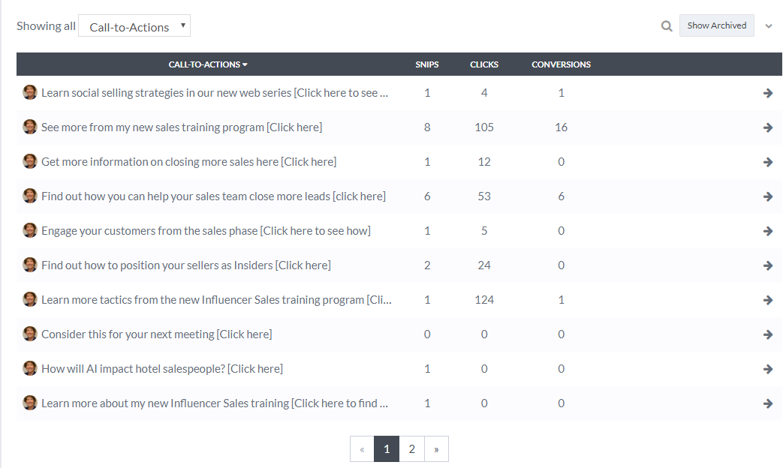
Notes:
53

Slide 67
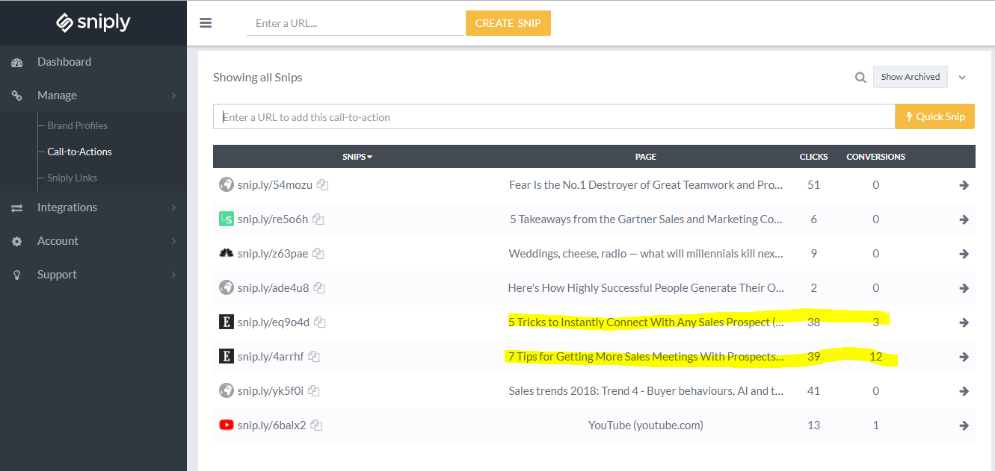
Notes:
55
Video -

Slide 68
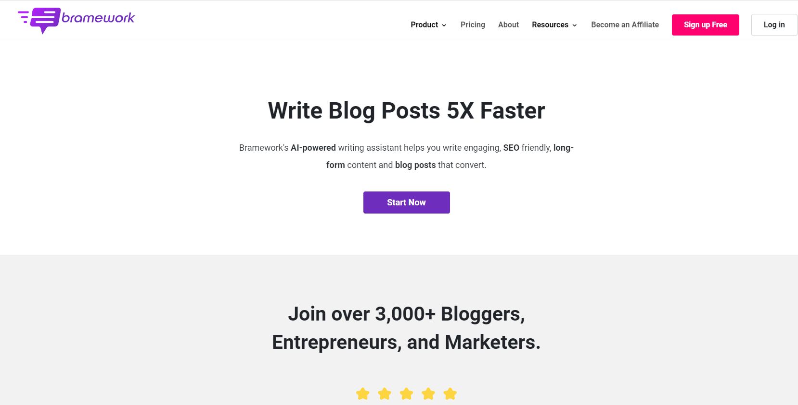
Bramework

Slide 69
Bramework

Slide 70
BONUS TIP
Encourage your association members to like and share your content
Notes:
We all say that everyone who works at the hotel is really a salesperson, but here is where they can really step up and BE sellers. Ask your leadership team to share your content. It helps position YOU as a thought leader, it gets more engagements from your posts which helps the social algorhtyms and you are helping your team become more valuable.
QUESTIONS?
As you saw from the examples, you don’t necessarily need to CREATE the content that you share – you can share from articles, blog posts, podcasts that others have created but that might have some interest to your audience. Remember way back at the beginning of this session when we talked about how much of business travel will be sales focused? My big recommendation right now is to share content that sales people might find helpful. There are a ton of apps out there that can help you find great sales content – Buzzsumo and Spark Toro are two of my favorites. But for the rest of our time together, I want to focus on how you can also create your own interesting and compelling content. And I promise it will be fast and easy!

Slide 71
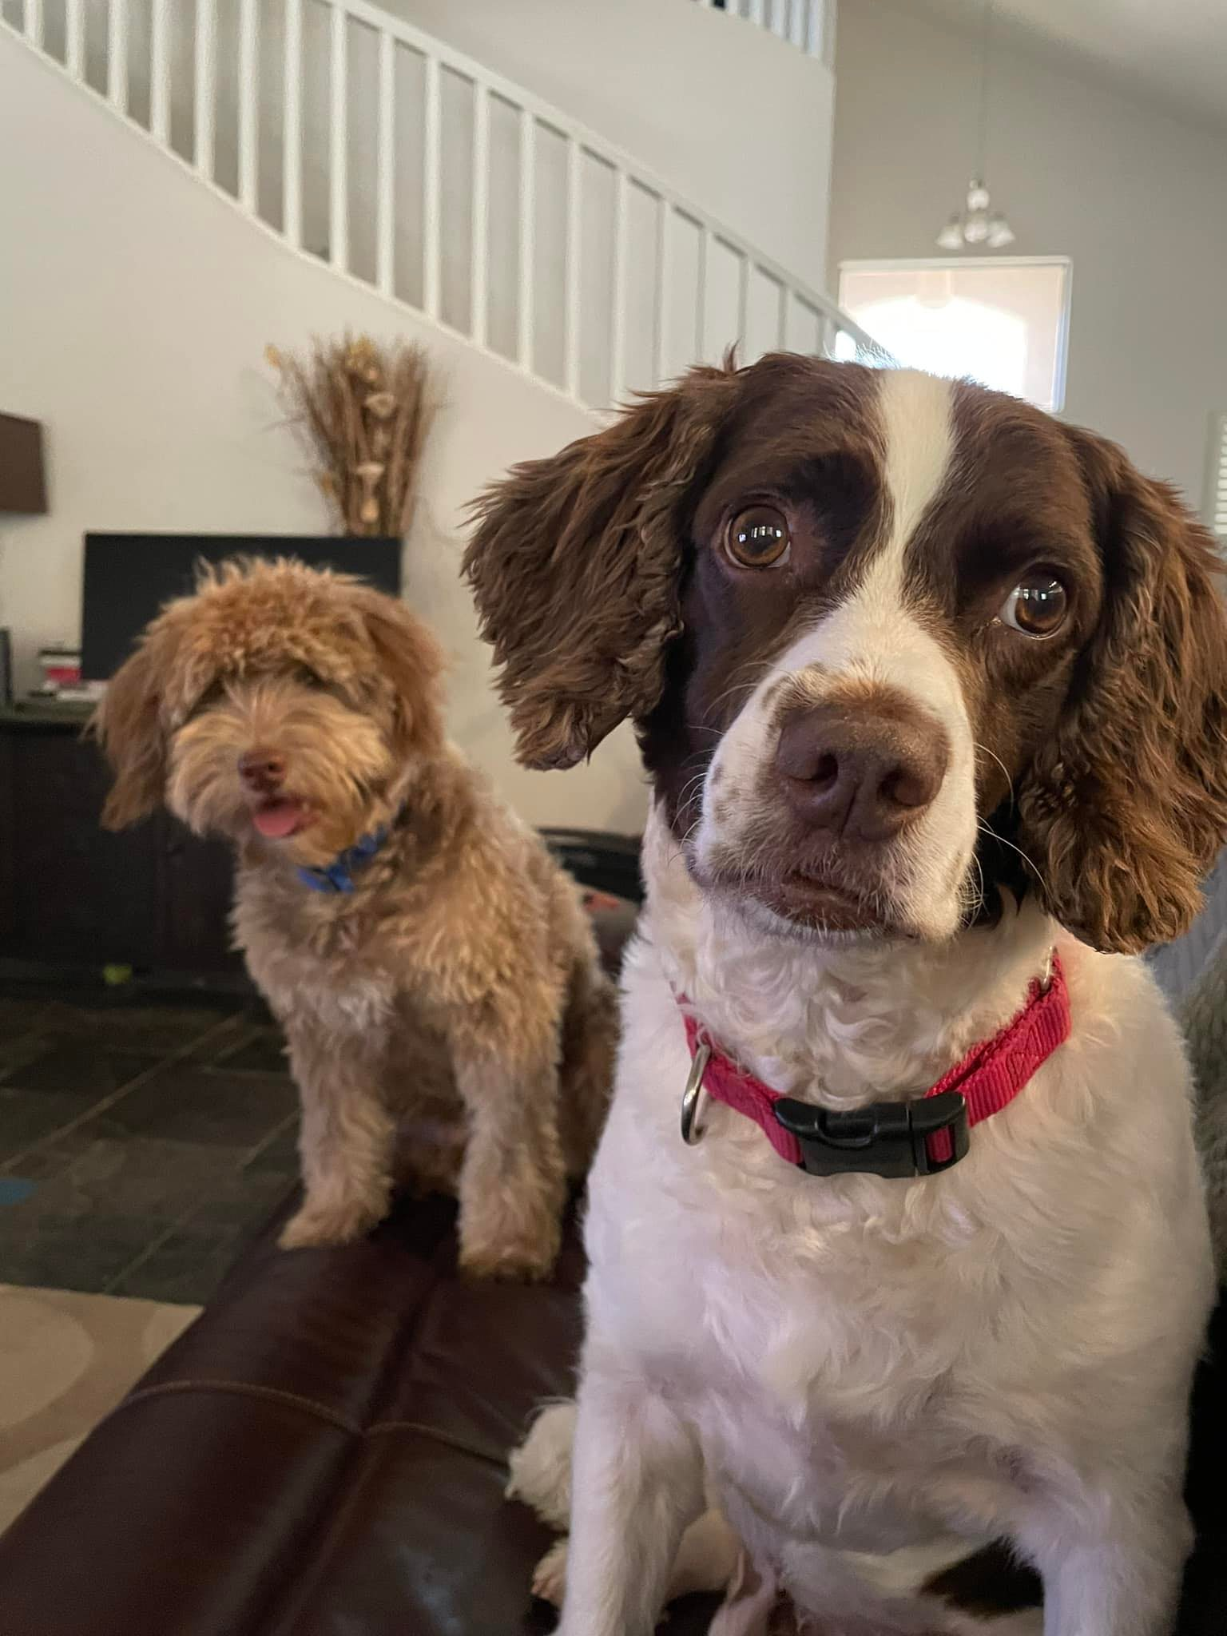
Questions?
Holly Zoba
Holly@scoutsimply.com
Notes:
https://calendly.com/holly-41/30min?month=2022-04

Slide 72
VIDEO SALES MESSAGING
Because It Works
Notes:
Our final topic in this branding arena is video sales messaging. Why video emails? Because they work and they strengthen your brand as a trusted resource.

Slide 73
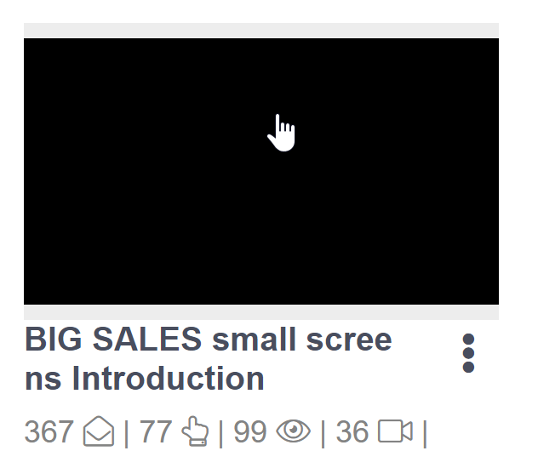
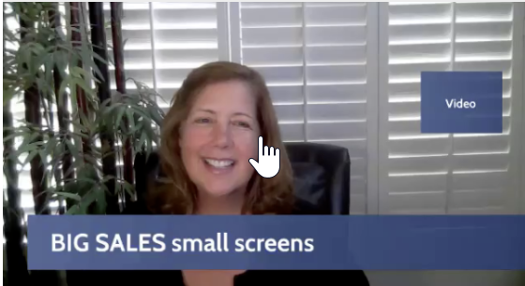
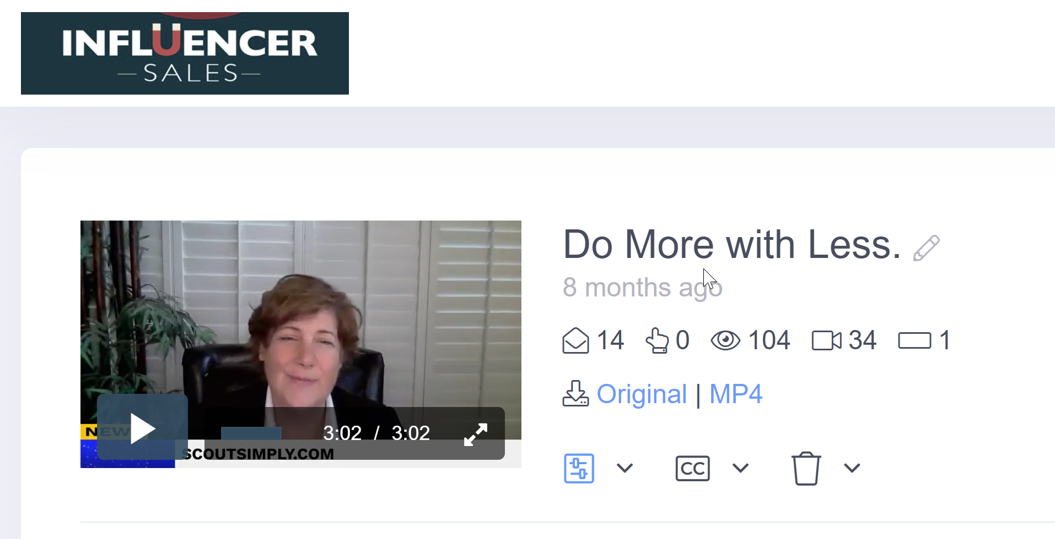
What is it?
Notes:
Video sales messaging can be as simple as you recording yourself with a personal message to one of your past clients. Hi, I was thinking about you – hope you are well. Let’s reconnect when you have a second to breathe. Or you can send them out to your entire emailing list and make them fancier – incorporating some text or graphics on the screen to reinforce part of your messaging. These videos can last anywhere from 15 seconds to 3 or 4 minutes, depending on your intent. You can send them via email, OR through LinkedIn messaging. So, like me, you might be thinking, nah, I’m good. I have zero intention of putting myself on camera and sending myself to as a video to anyone! I get that, I used to think exactly the same way.

Slide 74
Why?
82% of all traffic consumes video
25% of companies already successfully use video in sales successfully
Boost click through rates – 200%
Triple Response rates
Notes:
But then I kept reading all the data. I know very well that video is appealing to people and they consume it all day every day. And I kept reading about results of these video sales emails - click through rates going up by 200%. Triple response open rates. But probably what made me try it was that I felt like I was falling behind the curve and I hate that – 25% of all companies have already figured out how to use these successfully. So why is video messaging so effective?

Slide 75
Increases trust between you and your prospect
Notes:
Bottom line, video has been proven over and over to increase trust. All the research suggests that video is more trustworthy than both images AND text. And when you add an actual person, with their own words, tone and body language – client trusts rapidly accelerates.

Slide 76
Video Sales Messaging Accelerates Your Sales Process
65% visit your website
90% watching product videos helps them make purchasing decisions
75% late stage prospects who received a personal video message decide to buy
Notes:
This elevated level of trust has been shown to accelerates your sales process. It literally speeds up the whole thing. Once you send a video, 65% of viewers will visit your website. 90% say that watching product videos help them make sense of all the information. And 75% late stage were pushed over the buying edge once they saw a video message.

Slide 77
Response Rates
Notes:
If you look below these videos you can see some of my response rates. Video one I did as an emailer to 367 people. 77 people opened the email which is a 21% response. A typical email open rate is in the 3-7% range. But, you can see, it was either forwarded or watched multiple times because from 77 opens, 99 watched at least part of the video, and 36 people watched the whole thing. On the second video – my audience was more personal and targeted. I only sent it out to 14 people. I got 104 partial views and 34 complete watches. But, did I sell any classes? Of course I did. My ROI is insane because my investment was almost nothing.

Slide 78
Use Cases for Video Emails
Transactional
Educational
Inspirational

Slide 79
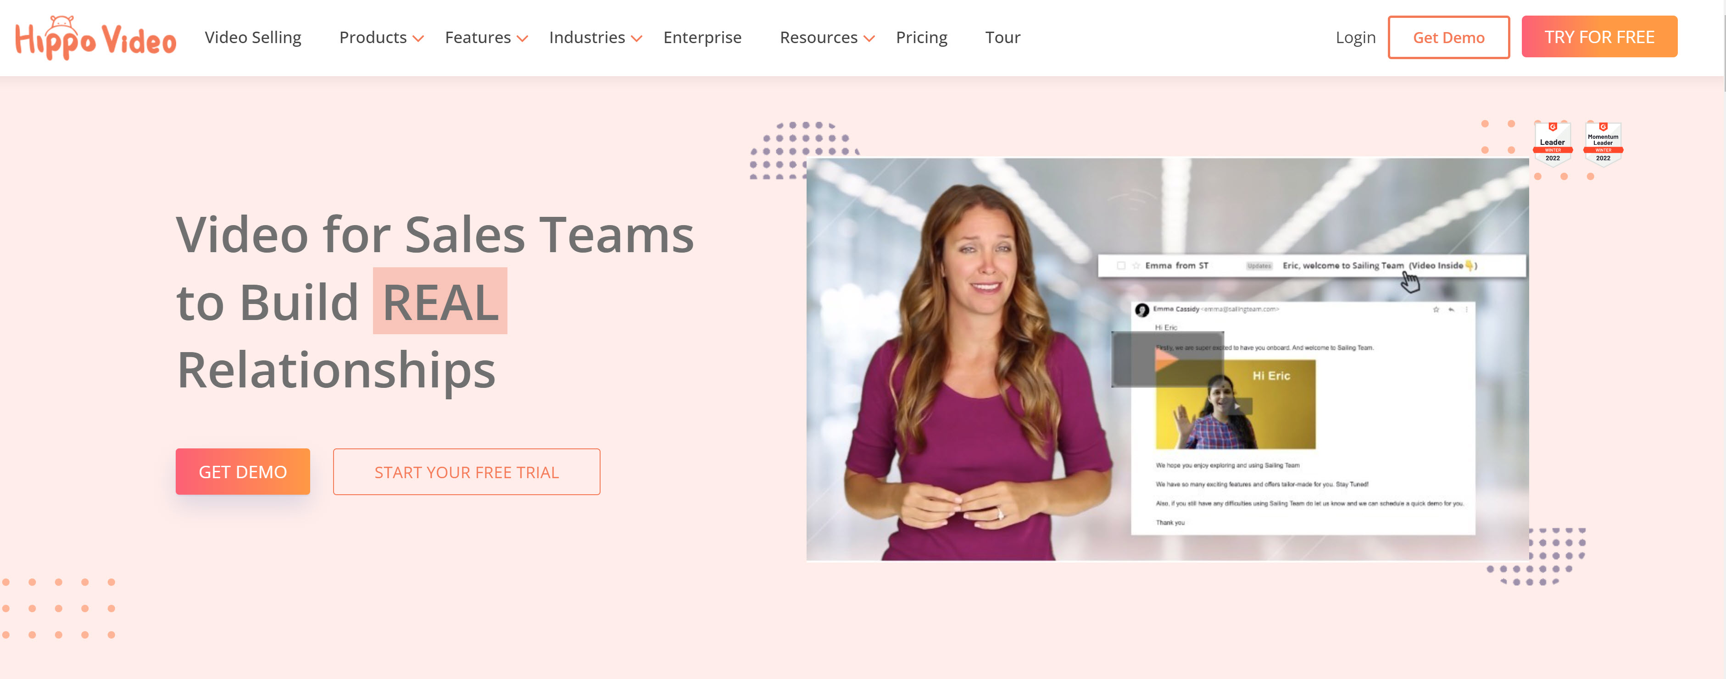
HippoVideo
Notes:
I am going to share one of my favorite video email apps with you – Hippovideo. There are about 100 video email apps and I have investigated many. Vidyard, Dubb, Loom and Hippovideo are probably my favorites but I have chosen Hippovideo for you because in addition to the software, Hippo also includes a ton of resources for ongoing video sales training with Jeffrey Gitmer! Also, there is a really good free version! Like the other apps, sign up for the free trial and at the end of the program, katie and Angelis will be surveying you about which apps you want to purchase.

Slide 80
Next Steps
Get recommendations – from clients
Increase your activities – like, comment, share
Post content of value
Grow your network
Try Video Email Messaging
Update your profile
Notes:
So I know – a LOT of info crammed into two hours! But to recap – it is really worth your time to invest insocial selling. And the best place to invest that time is LinkedIn. Create a TRP – trusted resource profile, grow your network, like and share other people’s content – and comment whenever you have anything of value to add. Finally make sure you share content using sniply. https://calendly.com/holly-41/30min?month=2022-04

Slide 81
Questions?
Holly Zoba
Holly@scoutsimply.com
THANK YOU!
Notes:
https://calendly.com/holly-41/30min?month=2022-04

